Slide 1
Abstract
Come and learn how to create a cross-team project by using enthusiastic colleagues as contributors. Wouldn’t you like to have every piece of code in your company to be written only once? I know I would! That’s why I’ve created a central Git repository for all standardized code within the company. To stimulate more engagement and collaboration, I applied open-source practices. To keep the intellectual property ours, I kept it within the company borders: InnerSourcing. To make InnerSourcing a success, you need to stimulate your colleagues to contribute. Make it worth their while, write clear documentation, and make it easy to add value. After this talk, you’ll be aware of some of the success formulas and pitfalls that InnerSourcing such a project brings, before encountering them yourself. You’ll learn some effective methods to maintain a high-quality codebase while keeping it accessible to colleagues with varying skill levels. Join me in this talk and find out how you can apply our lessons learned to your own InnerSourcing project.

Slide 2
Next Up:
Jelle de Graaf

Slide 3
3
3

Slide 4
2

Slide 5
1

Slide 6
Successfully InnerSourcing a central automation platform
Jelle de Graaf

Slide 7
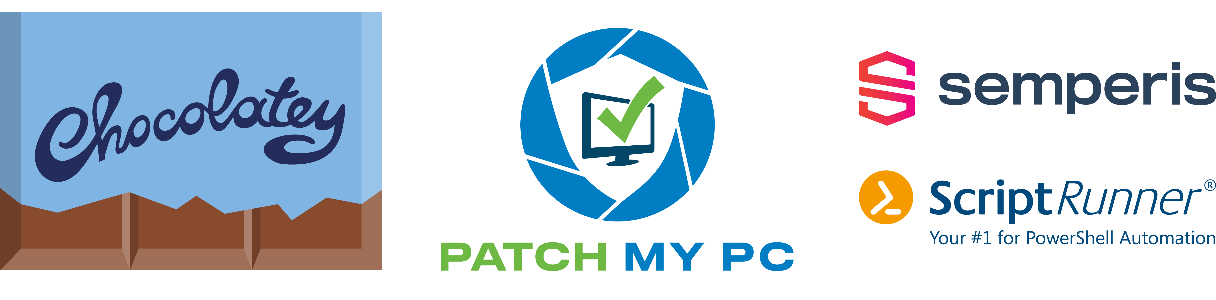
Many thanks to our sponsors:

Slide 8





Jelle de Graaf
OGD ict-diensten
DevOps engineer
Automation, PowerShell, gaming
/jelledegraaf
Notes:
OGD ict-diensten, an IT service provider in The Netherlands
Current activities: DevOps engineer, automating everything
Things I like: Automation, PowerShell, gaming on any possible platform (even PowerShell)

Slide 9



blah blah blah
Notes:
As an IT service provider, we have a lot of people writing scripts for customers. One problem with this is that there’s a lot of room for overlap. I don’t know how many copies of a script that sends an e-mail message are present in our DevOps organization, but I’m sure that it doesn’t fit on one hand. A few colleagues came up with the idea of creating a repository where everyone could place their scripts, to be shared with everybody. It started slow, but gradually gained traction and more and more content. It matured from just a repository with random scripts, to an Azure DevOps project containing multiple repositories with PowerShell modules, pipelines with common and generic scripts, artifact feeds to download the code from and a boards section for collaboration.
What is the dream? We would love to write a PowerShell function or script for a specific function only once. Then we place it in our central project, for everybody to use. With that we prevent doing work more than once, and make sure that everybody works in the same way.
Today, I’m going to tell you about how we created and developed this project and how we used InnerSourcing to do that.

Slide 10
InnerSourcing:
The sharing of knowledge, skills and code inside your organization, using open source style collaboration
Martin Woodward - The 5 Myths of InnerSource
Notes:
What does InnerSourcing mean? There are multiple definitions in circulation, this is one of them I like.

Slide 11







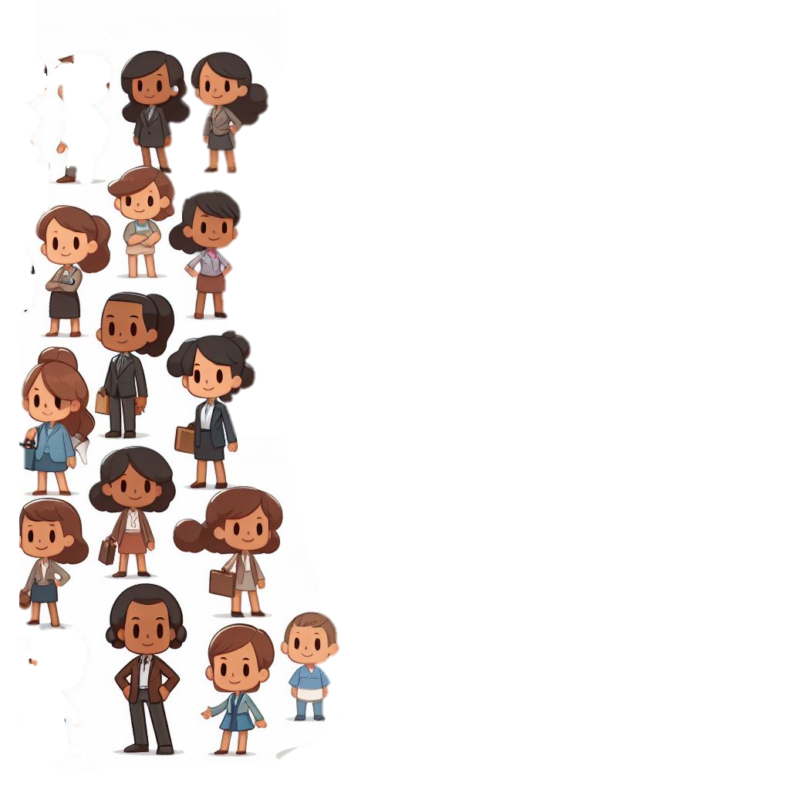

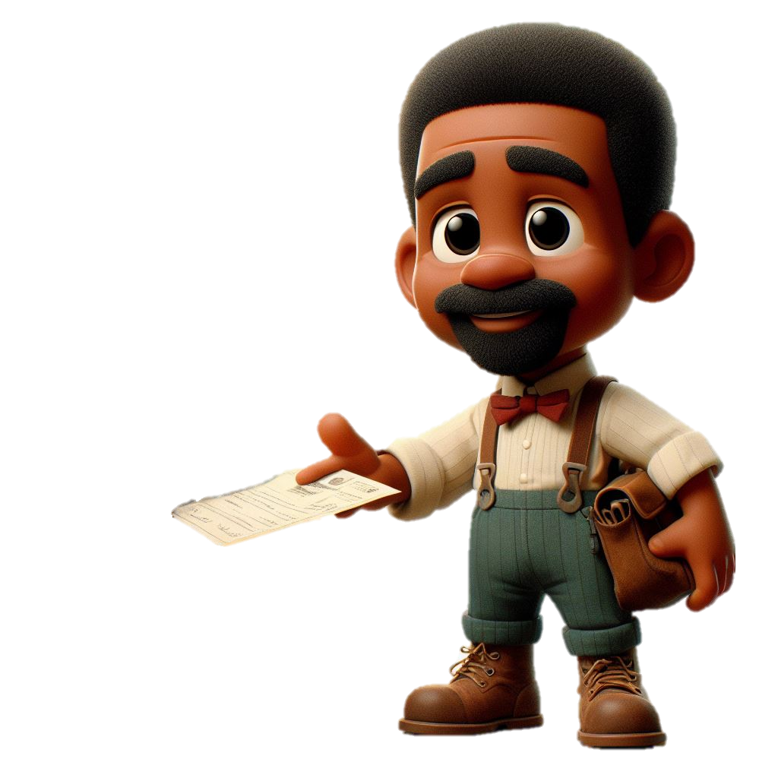
Open source principles
Transparency
Collaboration
Release early and often
Inclusive meritocracy
Community
Notes:
Ok. So. What does “open source” mean?
Your code and information are open for everybody
Everybody is free to participate
If you release often, you’ll discover more then when you don’t. It’s an iterative process
Make sure that you embrace the best ideas, not just the ideas from the usual people in the usual places
Unite different people around a common purpose to create synergy

Slide 12


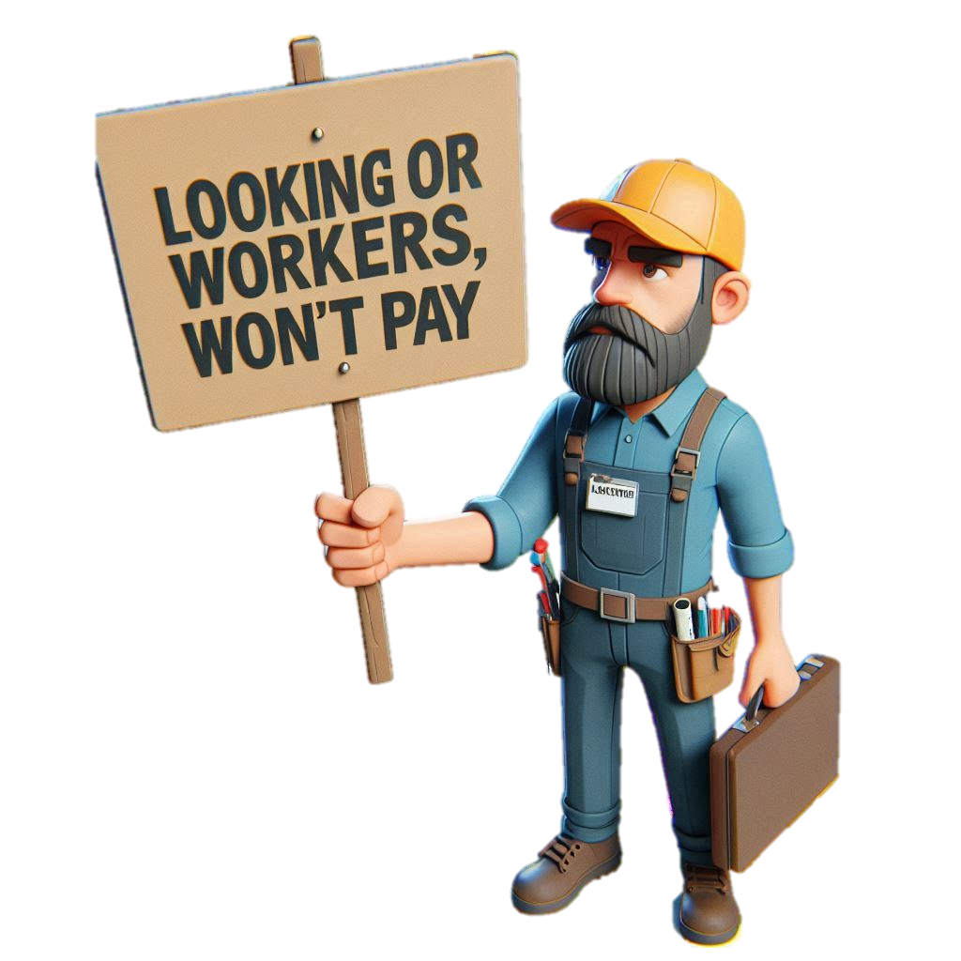


Yay InnerSourcing!
Notes:
So we thought: “let’s InnerSource this!”. We’re already colleagues from different teams, let’s continue that trend. We’ll receive free work from our colleagues. Maybe we can splash in some gamification in there, where people can earn points for contributing, they love that! We’ll build the platform and let others fill in the content on top of that and when everything is complete and pristine, we’ll launch the product. This will totally work for us!

Slide 13


5 Myths of InnerSource
We’ll get free work
Gamification
Tidy everything up
Framework Teams
InnerSource won’t work here
Notes:
You don’t just get free work. For collaboration, you have to invest in making it work
If all you offer to collaborators is stickers or badges, people aren’t incentivized enough to stick around.
Don’t feel obligated to have a perfect codebase. If it works and has tests, it’s good enough for production and it’s good enough to share.
Don’t use horizontal teams and force contributors into a rigid framework. Try to keep things modular.
InnerSource can work in many places, probably even yours.

Slide 14



We’ll get free work
Notes:
Free work

Slide 15
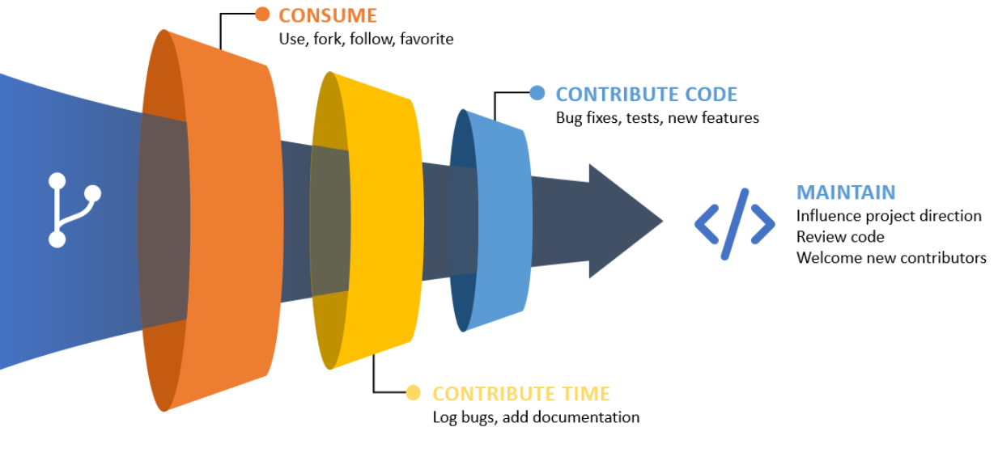
Contribution funnel
250
20
11
6
Notes:
https://youtu.be/5NGqFAvBjGc?si=JDVhOXLASUndyVq6&t=483
Know that even when InnerSourcing, you will still do most of the work yourself. The majority of involved people will just consume the product. A smaller group will invest time by reporting bugs, or providing feedback. An even smaller group will actually write code for the project. For our project, we have about 250 consumers, 20 time contributors, 11 code contributors and 6 maintainers.
What we received in raw numbers of hours spent, was less then what we invested in it to involve people. It did, however, result in a higher quality of the product, contributions from parts of the company with different viewing angles than our own and a more adopted product as a whole.

Slide 16



In the beginning…
Notes:
In the beginning, we had idea and a few enthusiastic colleagues. So we started working.
Bam! there was an Azure DevOps project.
Bam! There was the first repository.
Bam! There was the documentation. Just kidding. The documentation came much later. Everybody hates writing documentation. There were, however, multiple extra repositories for different PowerShell modules.

Slide 17
Important first steps
Tests
Rights structure
Version control
Notes:
There are a few things that were taken care of from the start:
Tests for the code. Always a good idea, but even more so when inviting everybody in to make changes to your code.
A hierarchical structure of contributors and maintainers. While everybody in the company is allowed to create branches and pull requests, only the core team is allowed to actually complete the pull requests. This is a necessary quality check, to make sure that one person can’t be responsible for faulty code in the product, be it intentionally, or unintentionally.
Speaking of which: always use some kind of version control when developing code.

Slide 18
Using version control on a shared code base is a bad idea.
Notes:
INTERACTION:
Quick question: Who here thinks using version control on a shared code base is a bad idea?
Invite people who raise their hand to discuss the topic later, over some drinks.

Slide 19
Later on
Product Owner
Templates for everything
‘Good first issue’ tag
Notifications for PR’s
Notes:
While the project started out with just a group of technical people, at a certain point we noticed indecisiveness. Decisions took too long to make and there was no general direction after the foundation had been laid. That’s when we introduced a product owner, to handle those issues.
To make sure that new people use the proper best practices, use as many templates as you can:
repository for new repo’s
for user stories
for pester tests
for pull requests
for PS modules
for PS functions
It is very nice to have a tag “Good first issue” lying around to slap on work items that don’t require a lot of knowledge about the project. People come from all kinds of places and most of the time don’t want to study for a few days just to understand what the work item is about.
We introduced teams messages in a dedicated channel, for when there are new pull requests. This makes sure they are noticed, even when people don’t check the Azure DevOps board on a daily basis.

Slide 20
Gamification
Notes:
Gamification

Slide 21
Motivation
Easy entering
Time allowed
Use the better product
Bribes
Notes:
Simply awarding people points for contributing doesn’t motivate them. You need to make it easy and attractive to participate in your project. It starts with having an interesting project, but that’s subjective.
The least you can do, is make it easy to step in. Have good documentation of the project so far, how-to’s on how to start, and a clear architecture.
In our case, time was a constraint. There were multiple colleagues who would have liked to write some code, but didn’t have the time to do so. Buy-in from higher management to allow people to invest a certain amount of time in the project goes a long way.
Another motivation was that this project was a matter of give and take. Every addition to the modules, meant a richer pool of functions. The more people give, the more there is to take.
Finally, you don’t necessarily have to be above bribes. Everybody likes stickers, that’s daily business here. Twice already we organized a day where people who are interested in the project came together to learn more about it, work together on work items, and enjoy a day away from the normal office, including a drinks, a commemorative token, snacks and a prize for the best feedback.

Slide 22
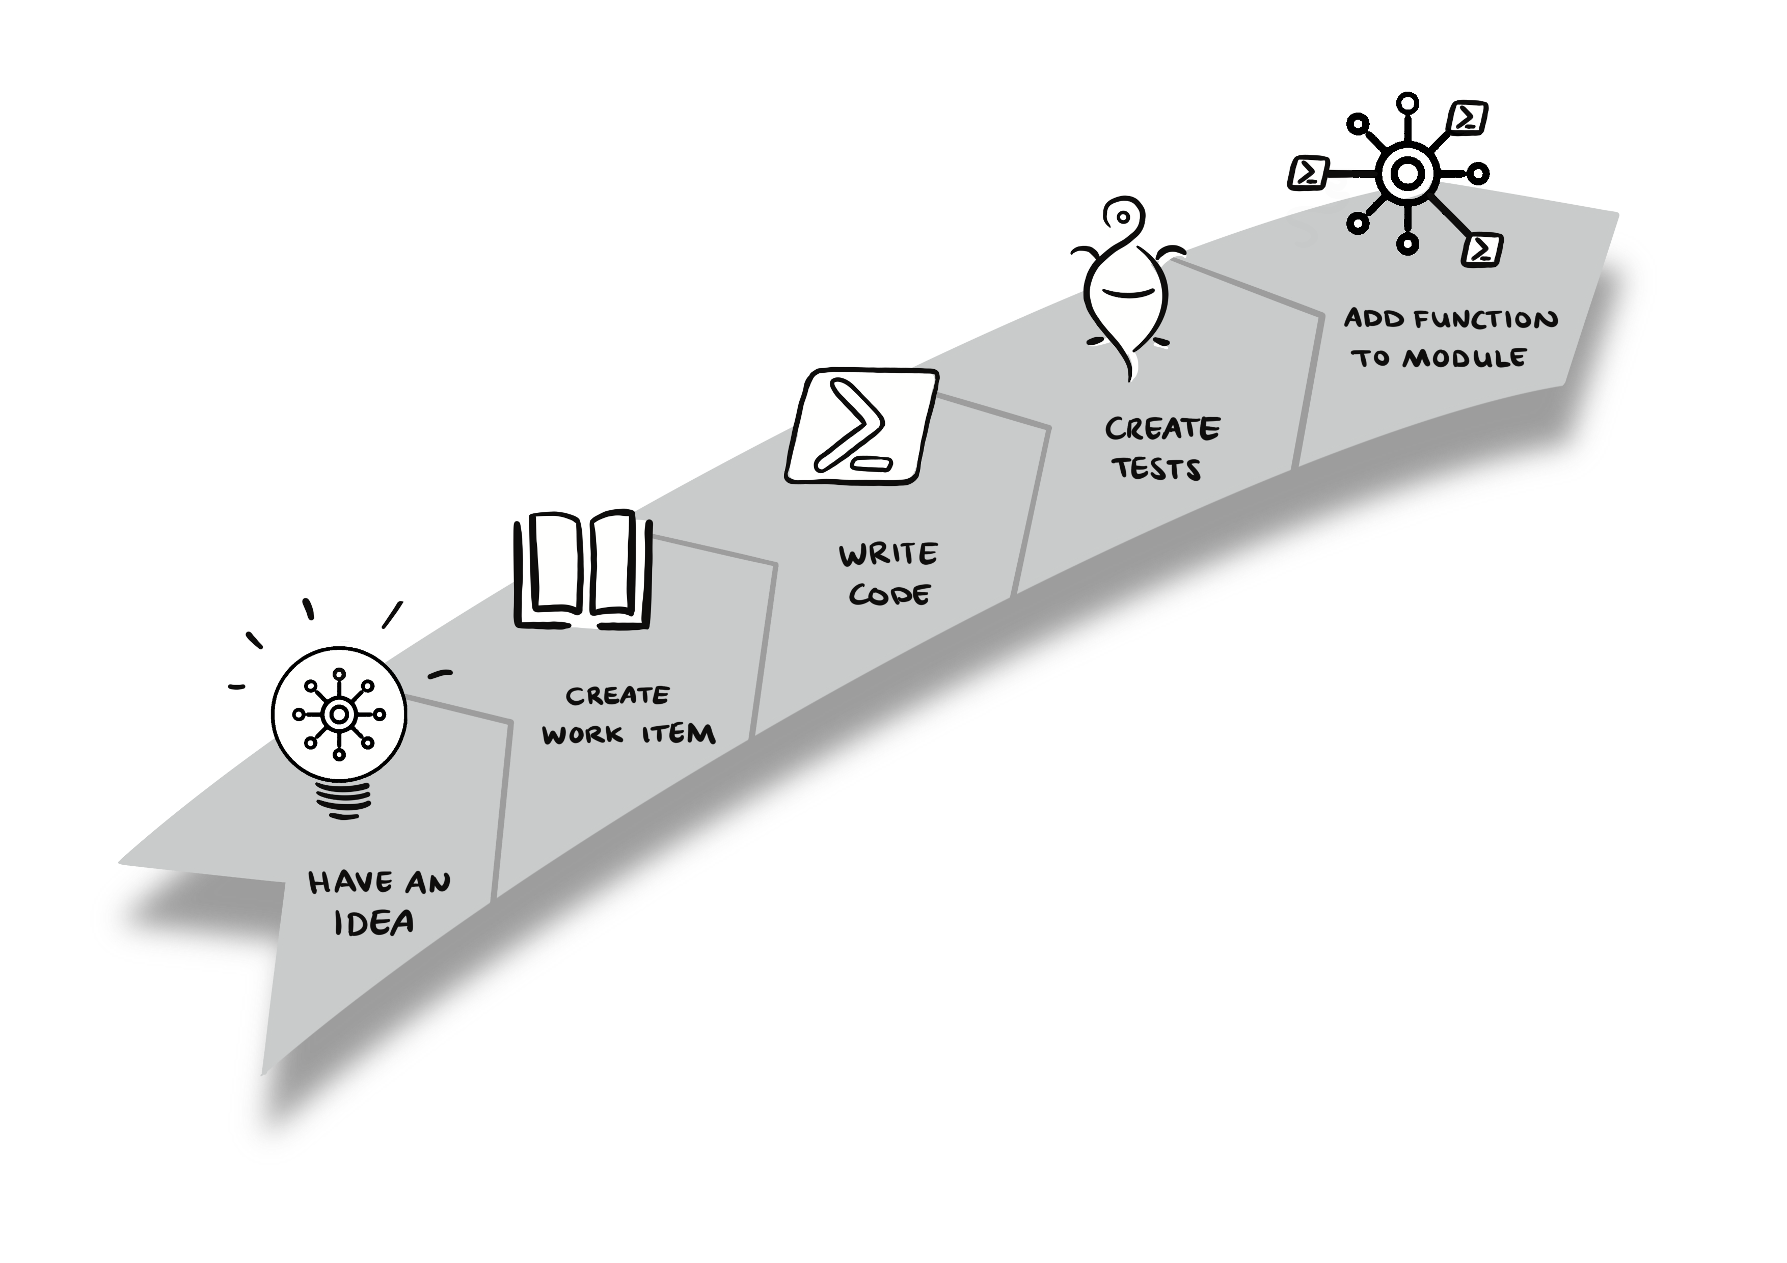
How to contribute
Notes:
A bit more about the accessibility of the project. There’s multiple things that need to be done before an idea turns into a feature. Not everybody van finish all the steps required. Make sure that there is capacity to fulfill all the steps by other people.
INTERACTION:
Ask everybody to stand up (hey, it’s good for you!) or if unable to stand up, raise your hand.
Ask everybody who never has any ideas about your work to sit down. Take note of the amount (percentage) of people still standing
Ask everybody who doesn’t know how to create a work item or ticket of some form to sit down
Ask everybody who doesn’t know how to write code to sit down
Ask everybody who doesn’t know how to create pester tests to sit down
Ask everybody who doesn’t know how to complete a pull request and read a manual to sit down.
Point out that if you don’t open the door for everybody, in every step, the only potential pool of contributors are the people still standing. All the ideas of the people in the first round are wasted.

Slide 23
Demos
We love Demos!

Slide 24
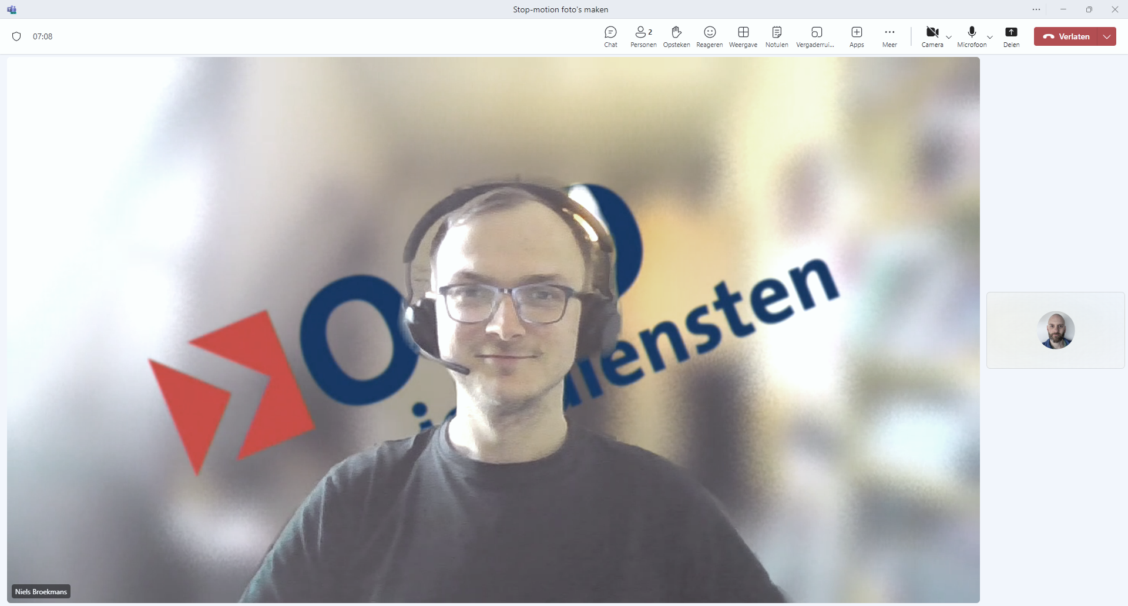
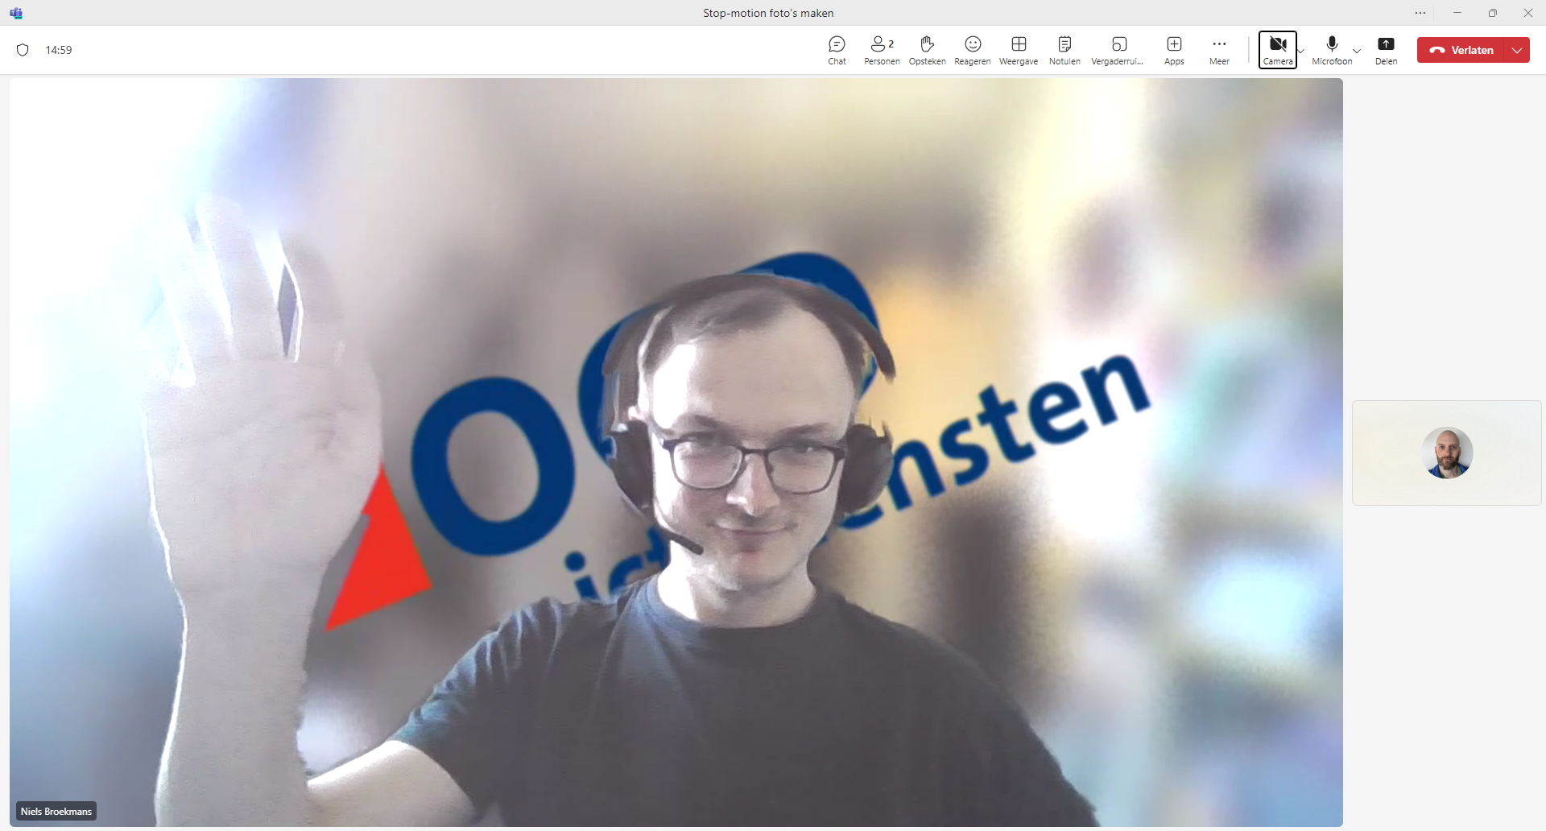
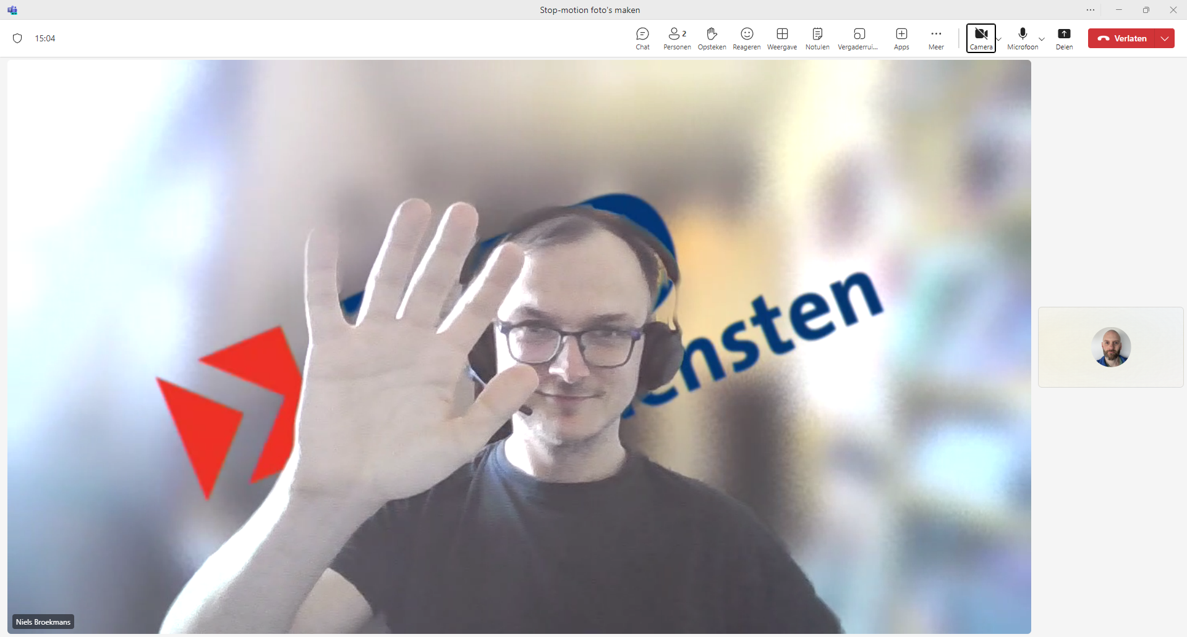
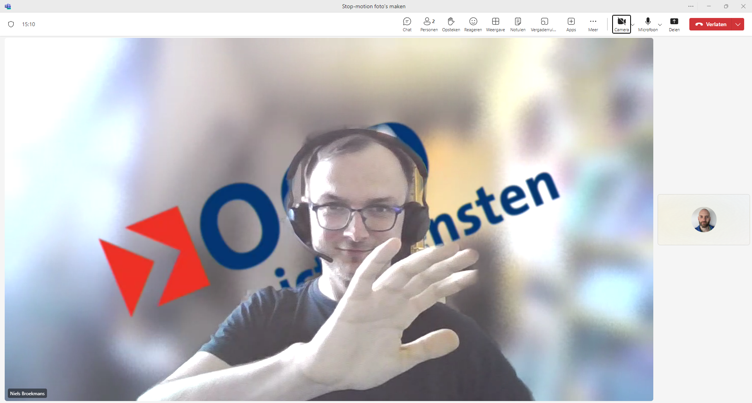
Notes:
Niels waves Hello

Slide 25
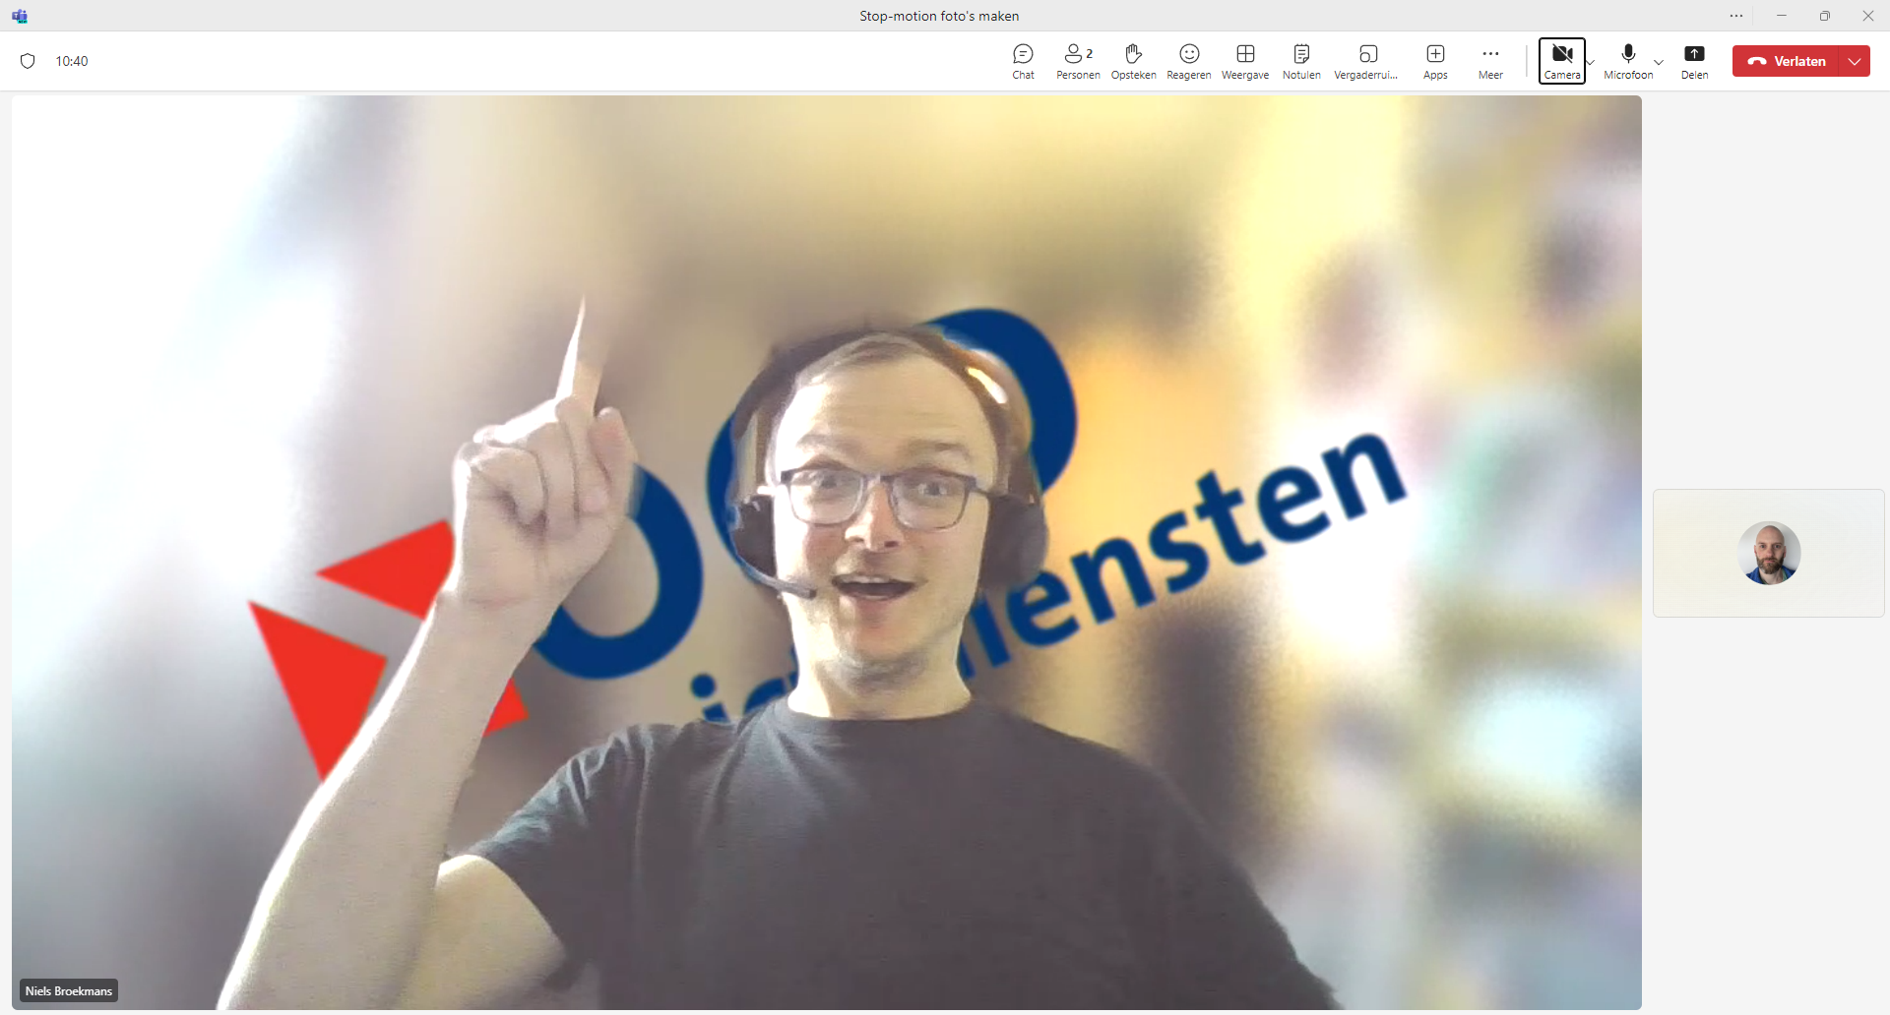

Slide 26
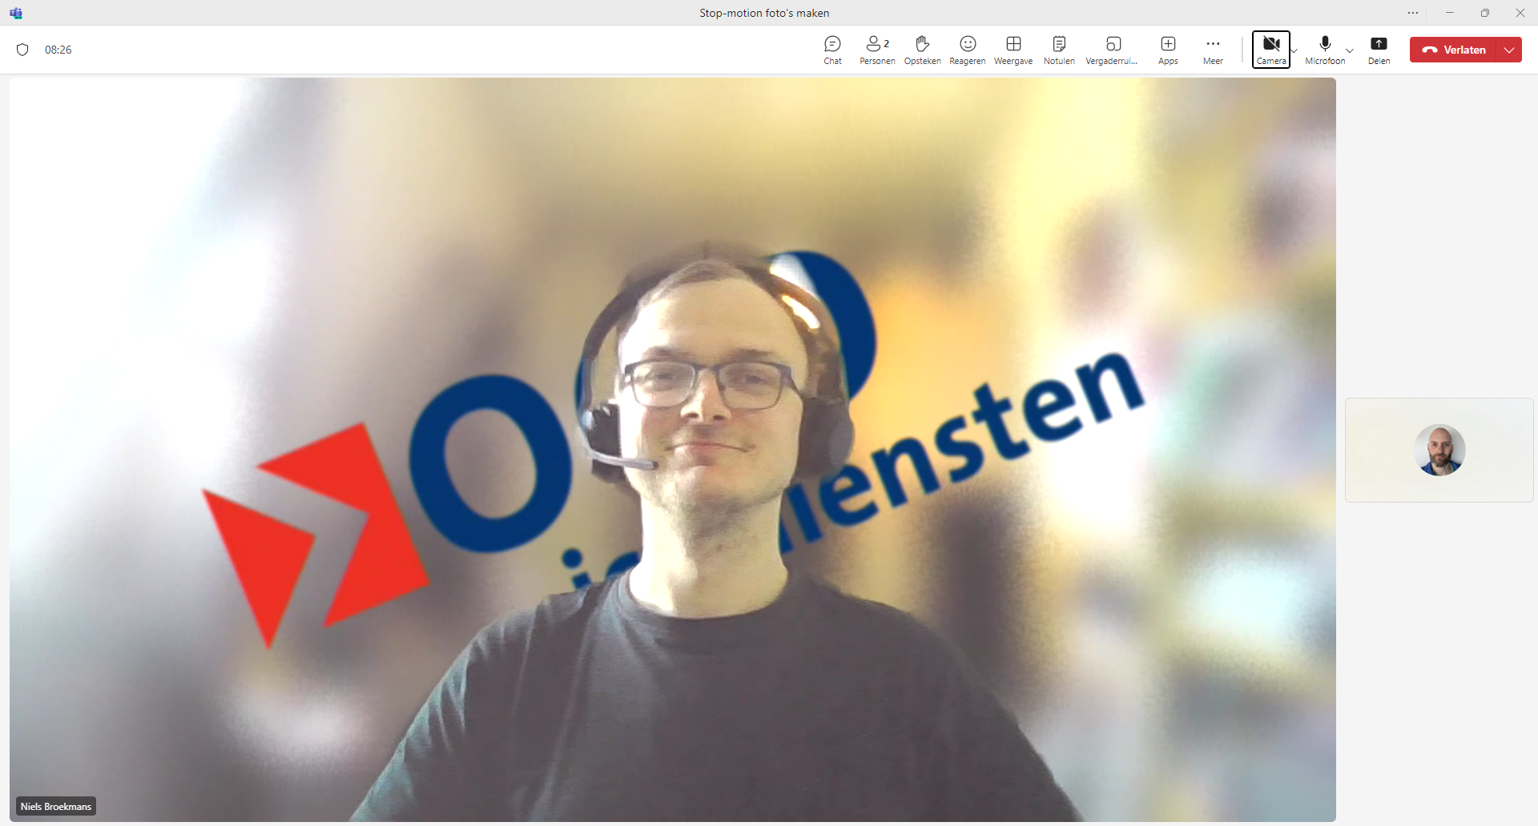
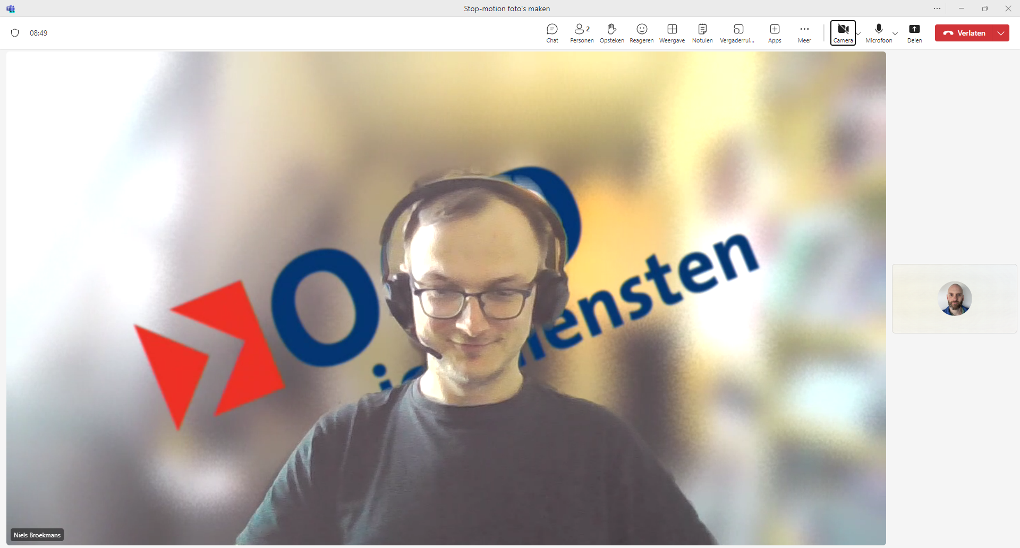
Notes:
Niels nods yes

Slide 27
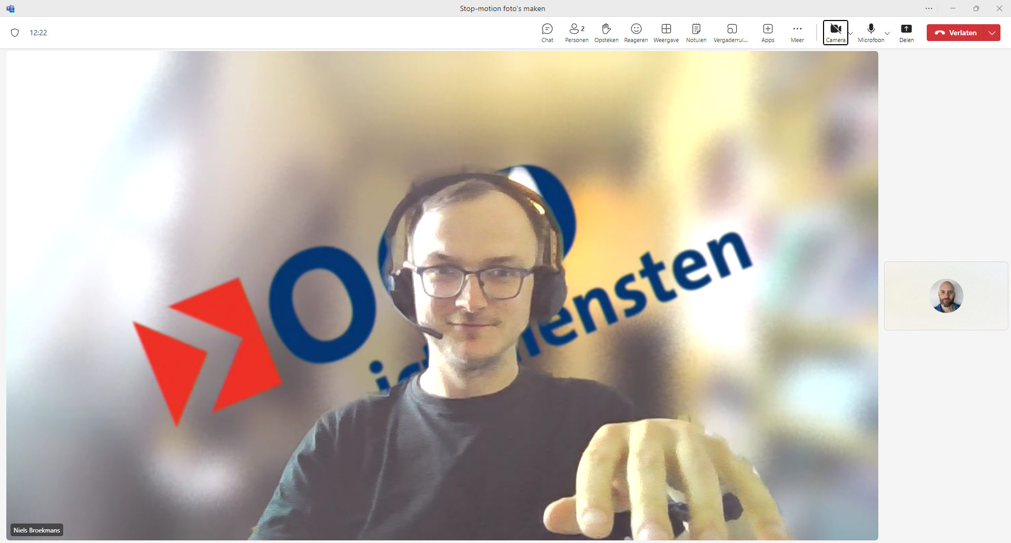
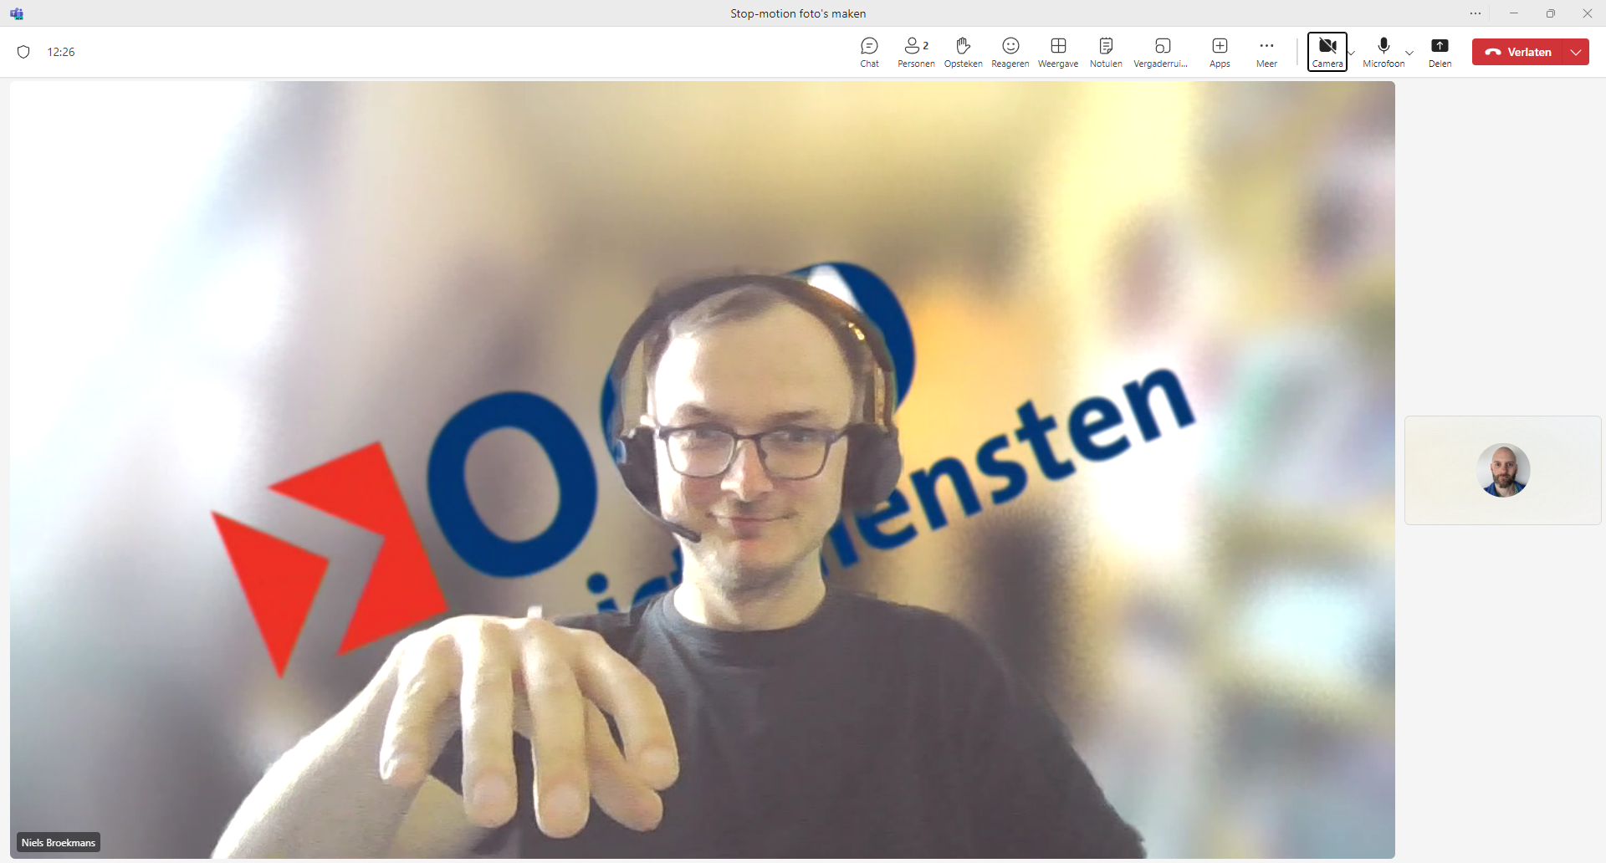
Notes:
Niels is typing relaxed

Slide 28
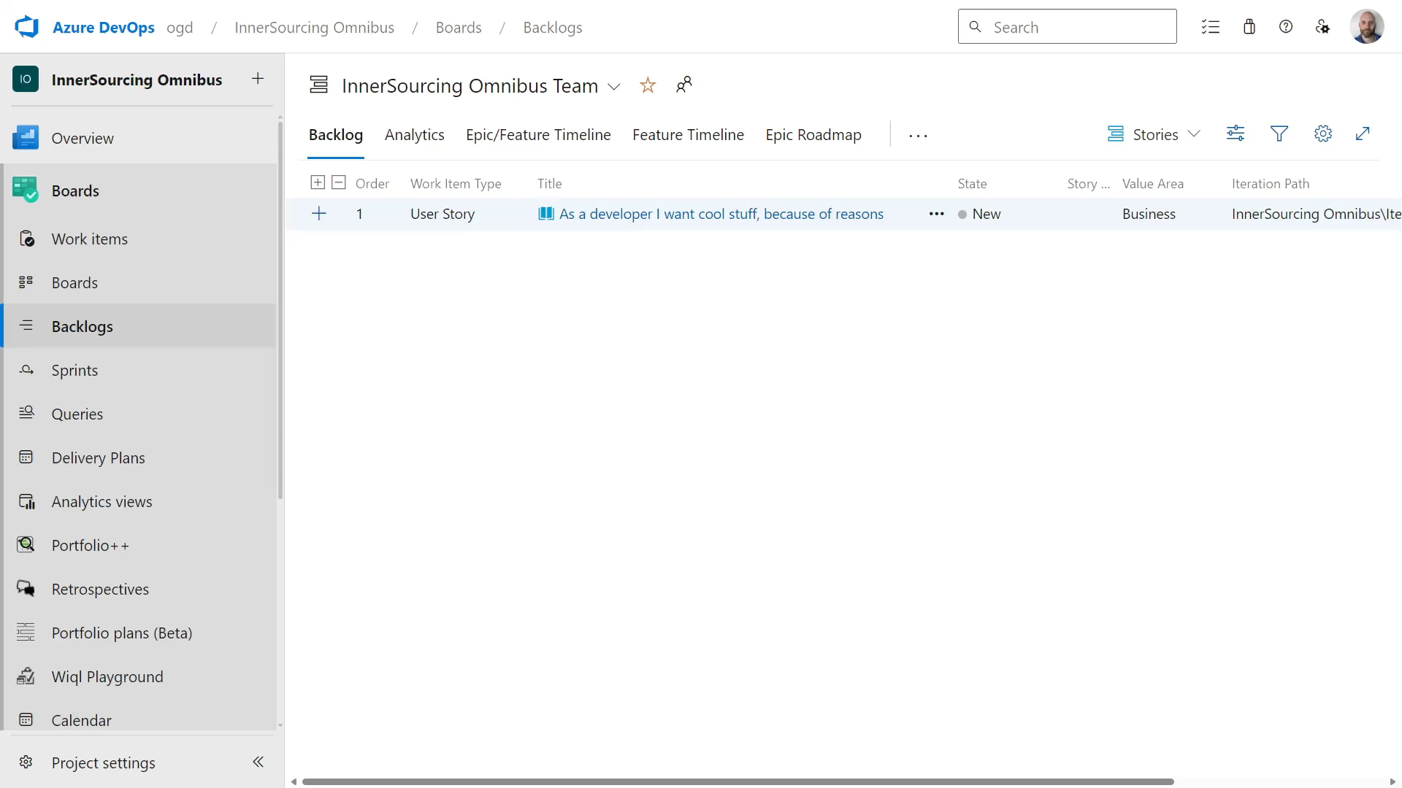
Notes:
Niels is creating a user story

Slide 29
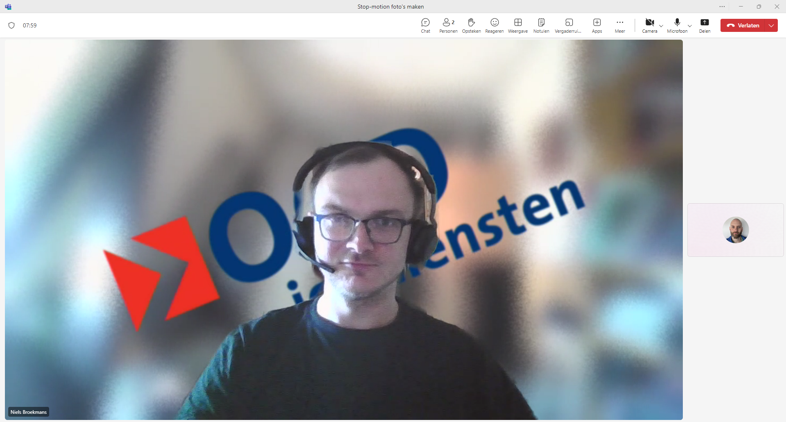
Notes:
Neutral

Slide 30
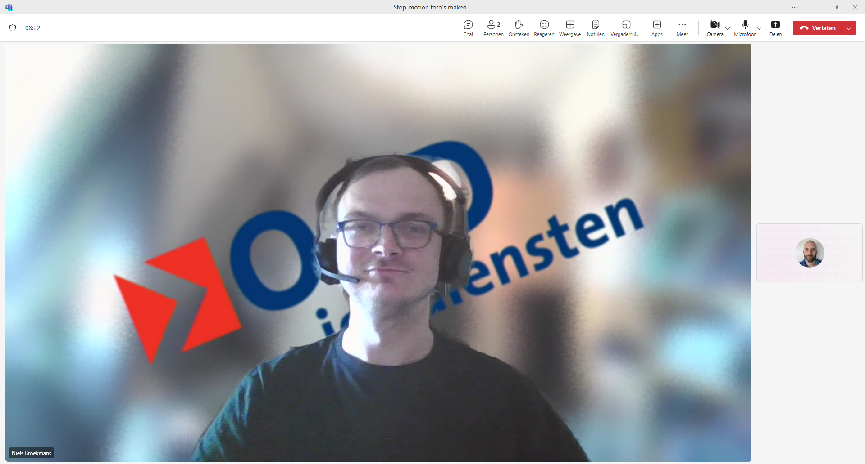
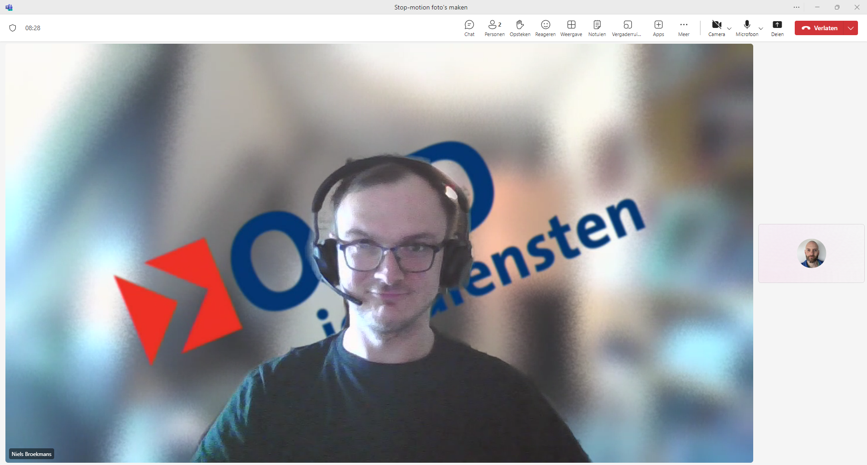
Notes:
Niels nods yes

Slide 31
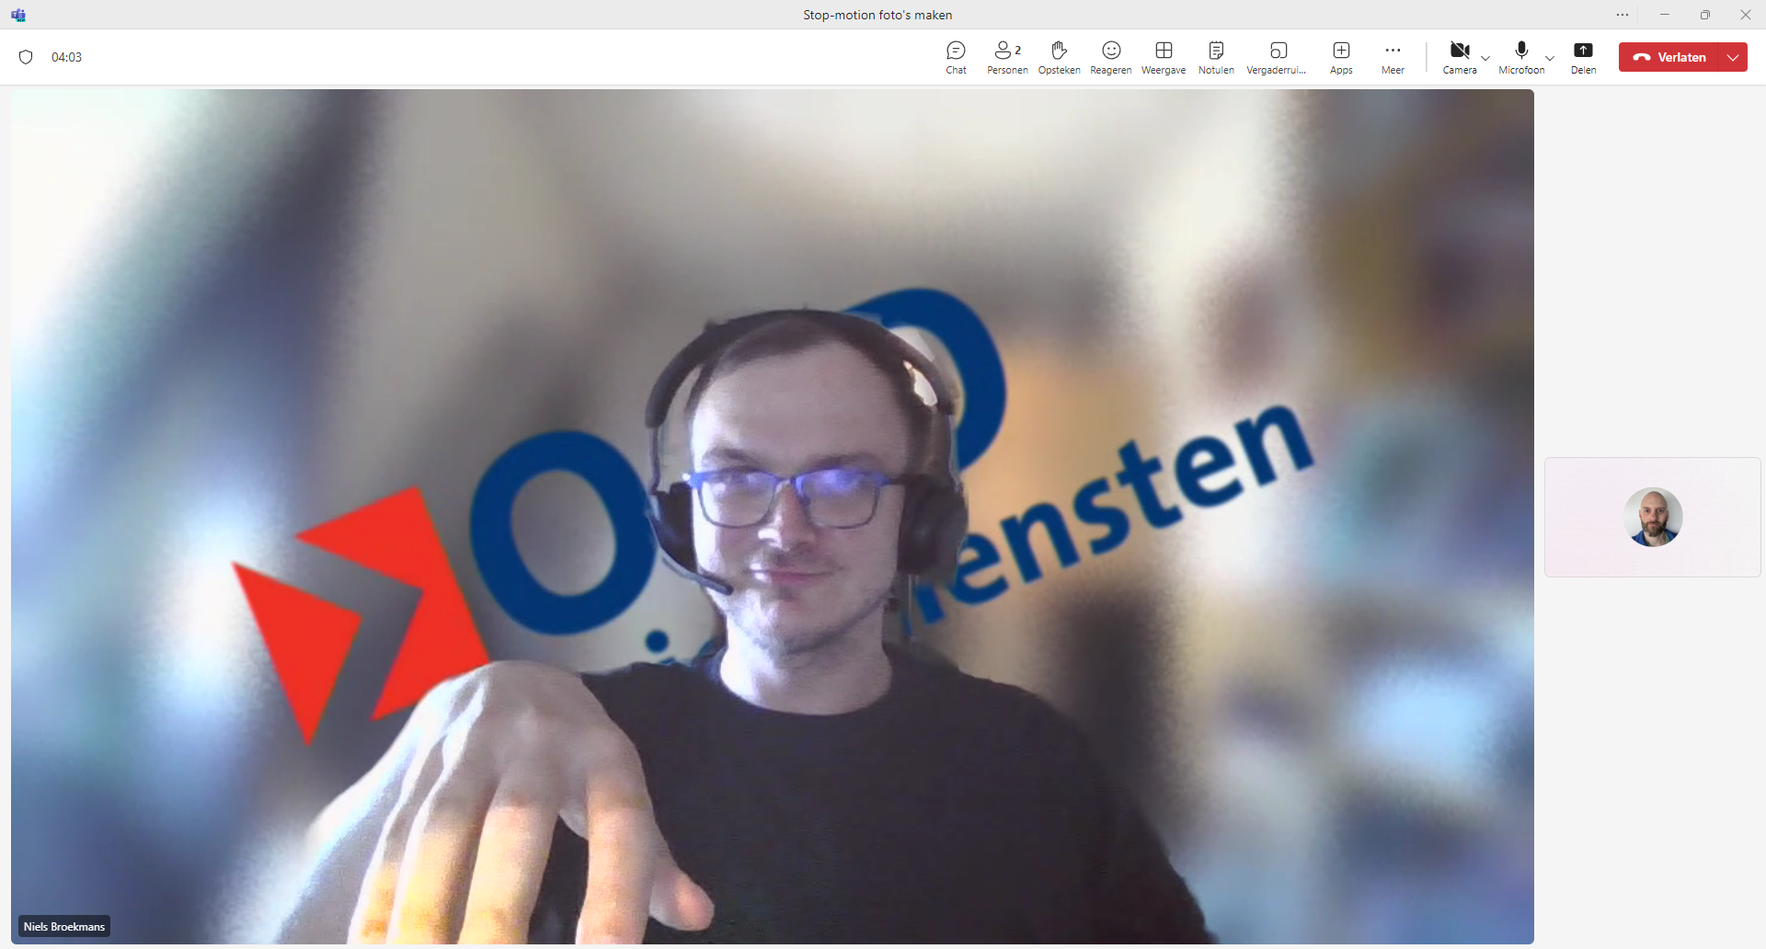
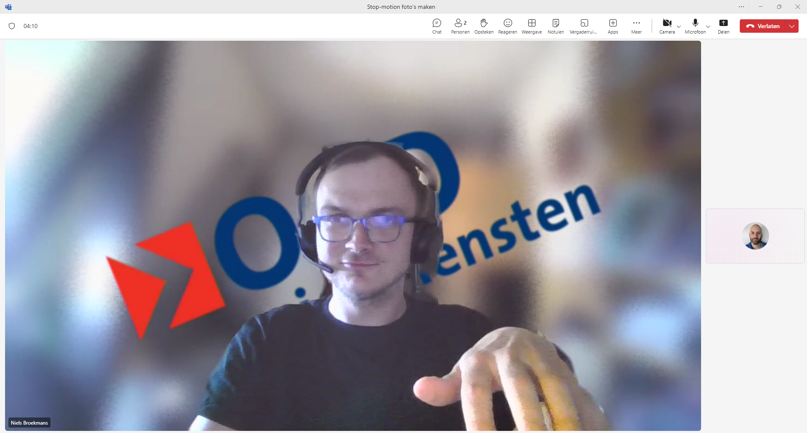
Notes:
Niels is typing concentrated

Slide 32
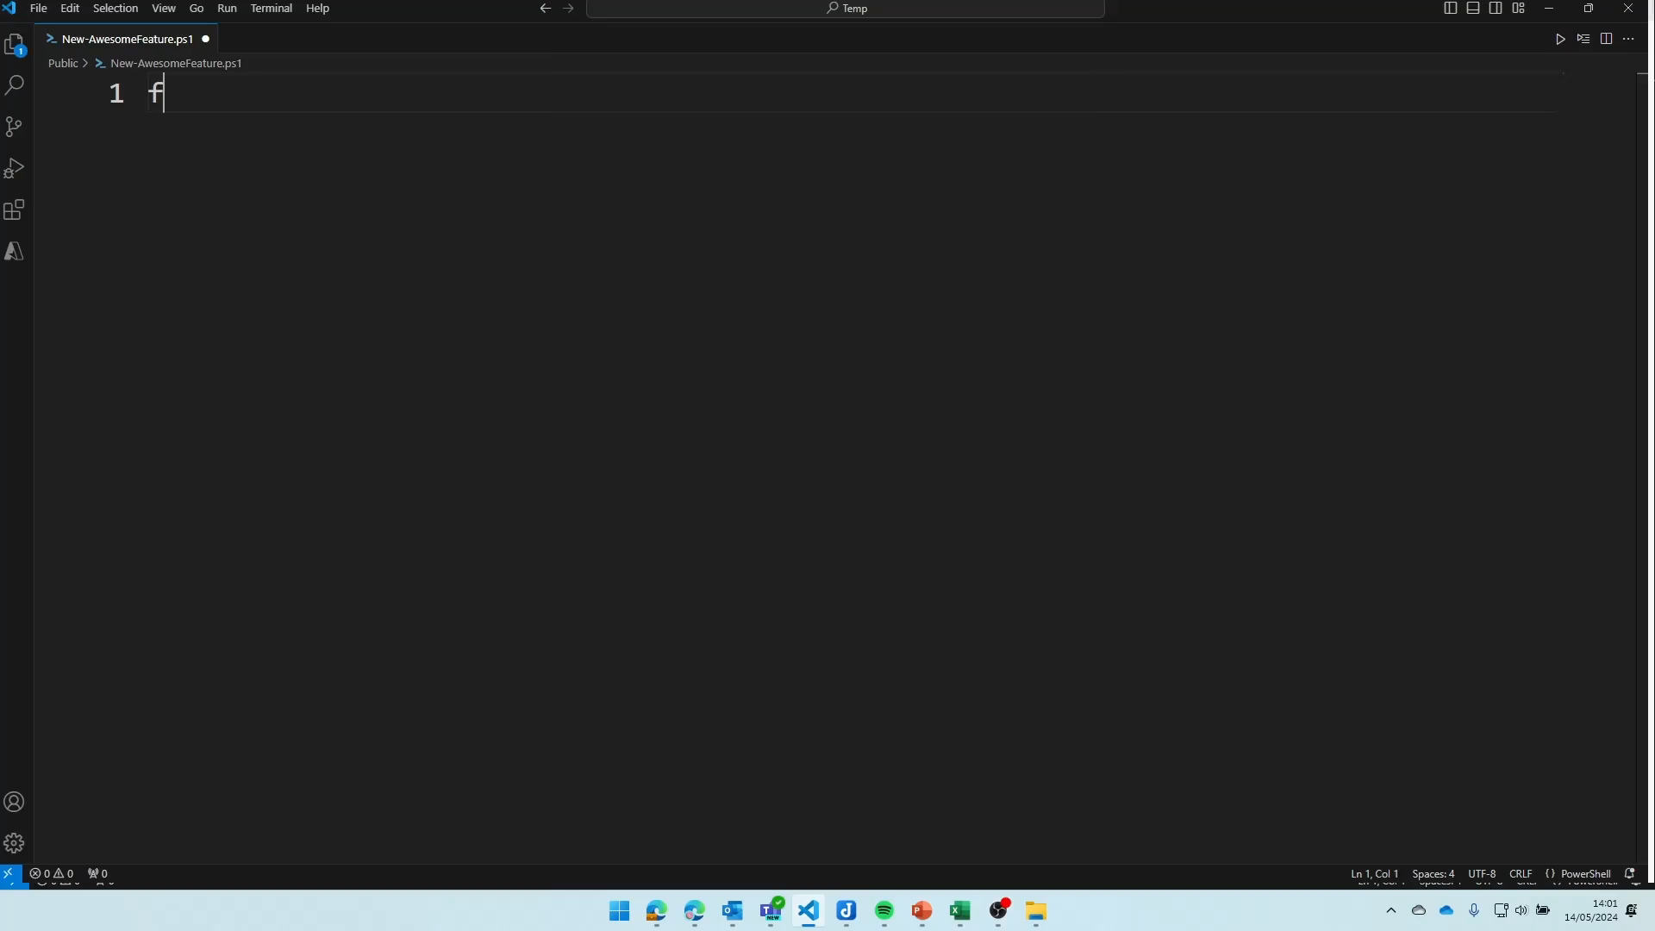
Notes:
Niels writes PowerShell code

Slide 33

Notes:
Neutral

Slide 34
Notes:
Niels nods yes

Slide 35
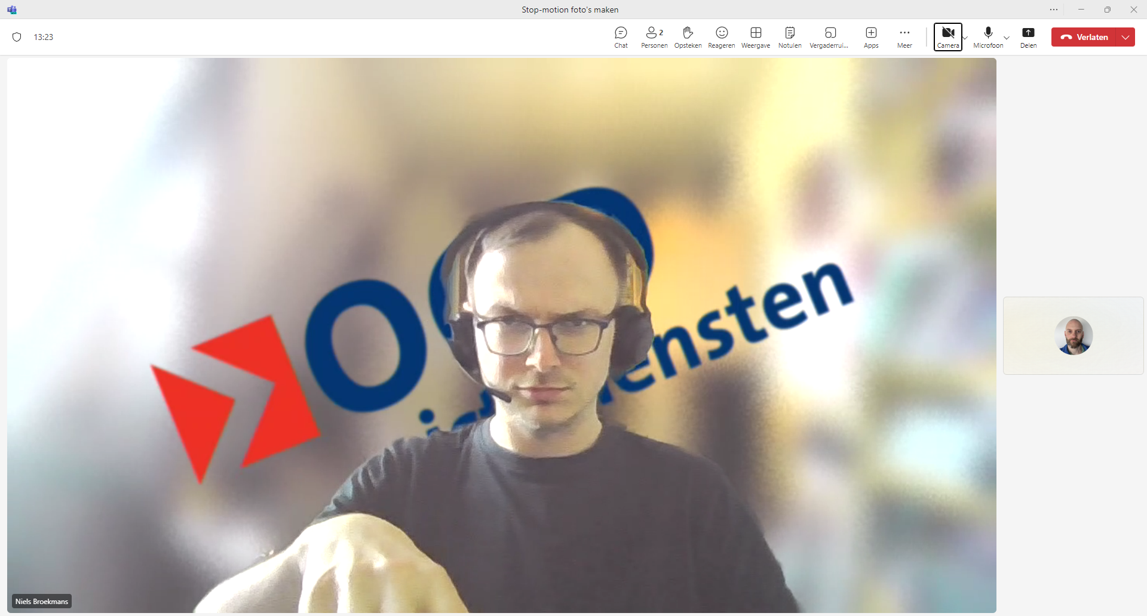
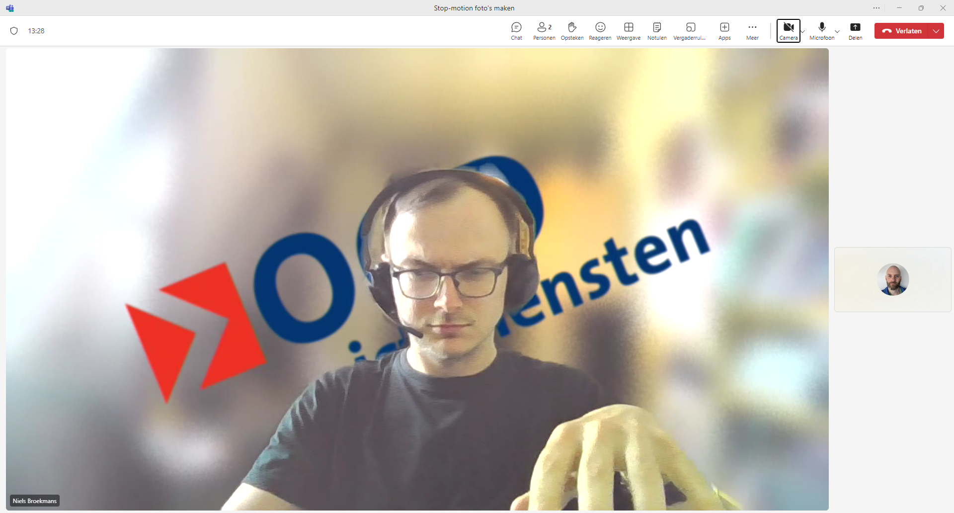
Notes:
Niels is typing with difficulty

Slide 36
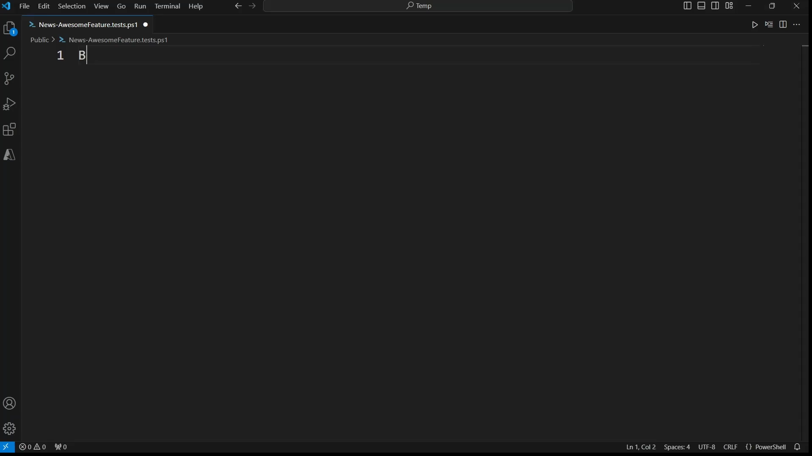
Notes:
Niels writes Pester tests

Slide 37
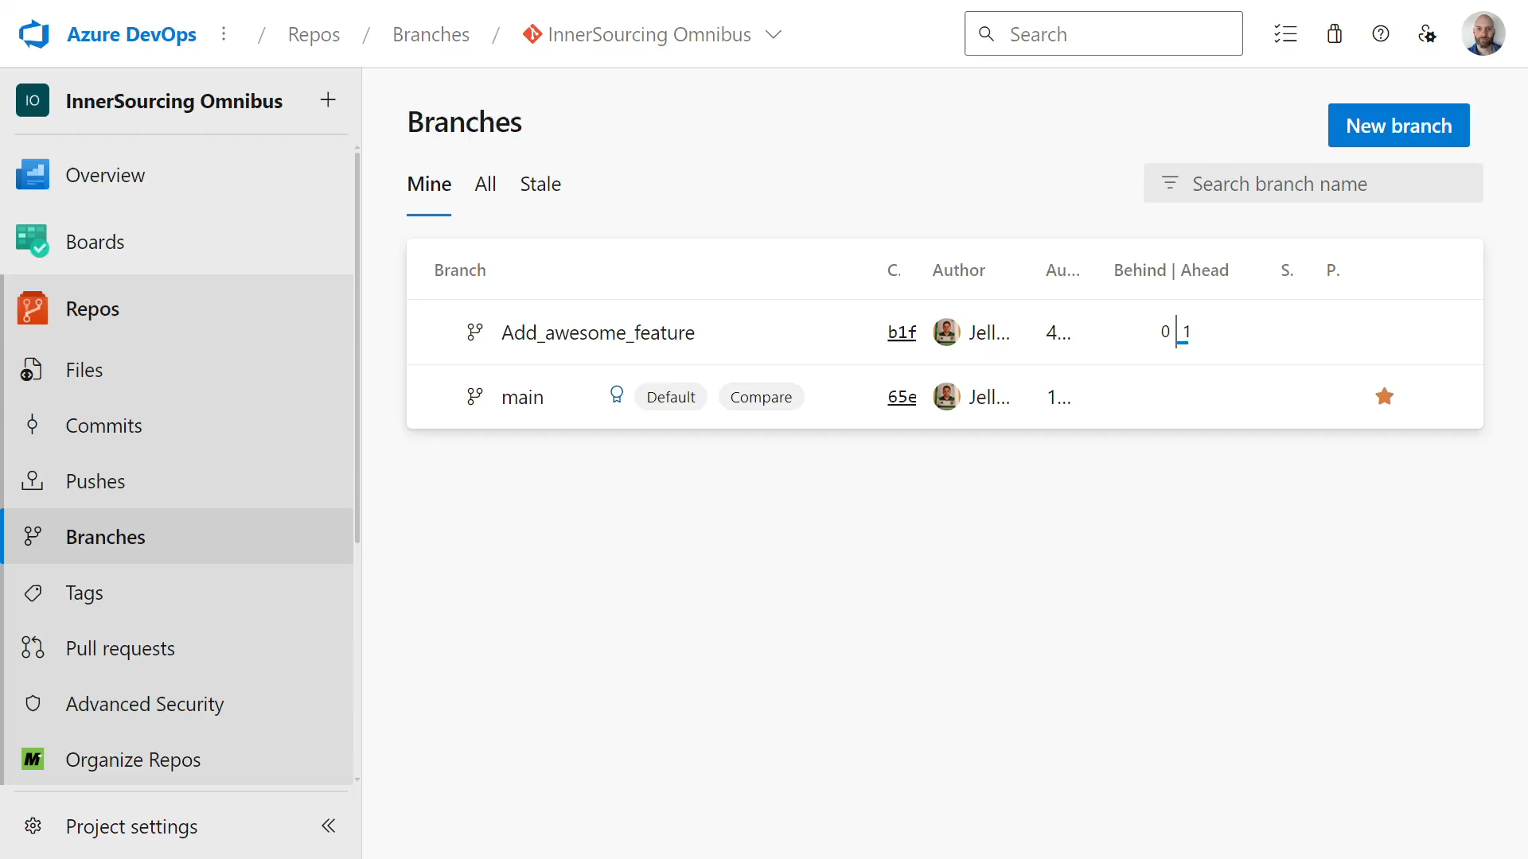
Notes:
Niels creates a pull request

Slide 38
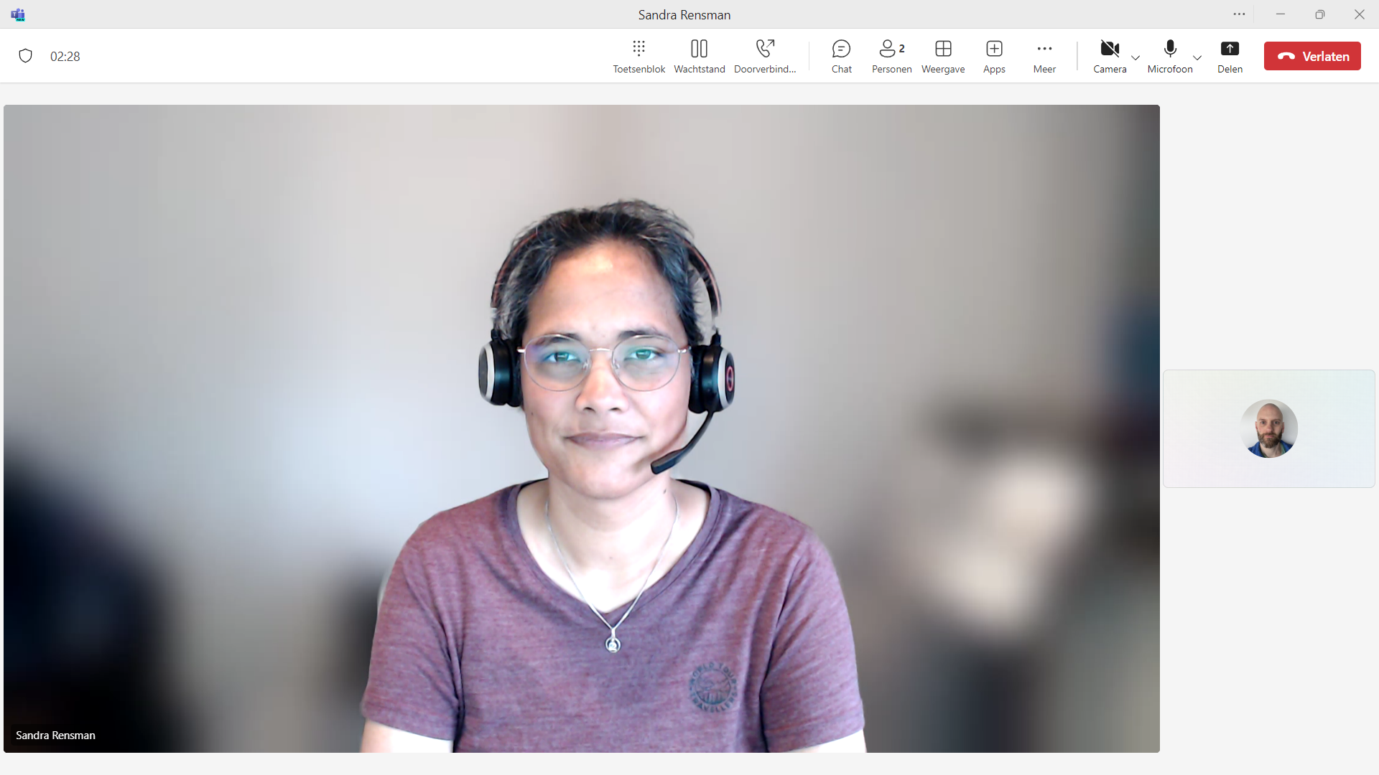
Notes:
Neutral

Slide 39
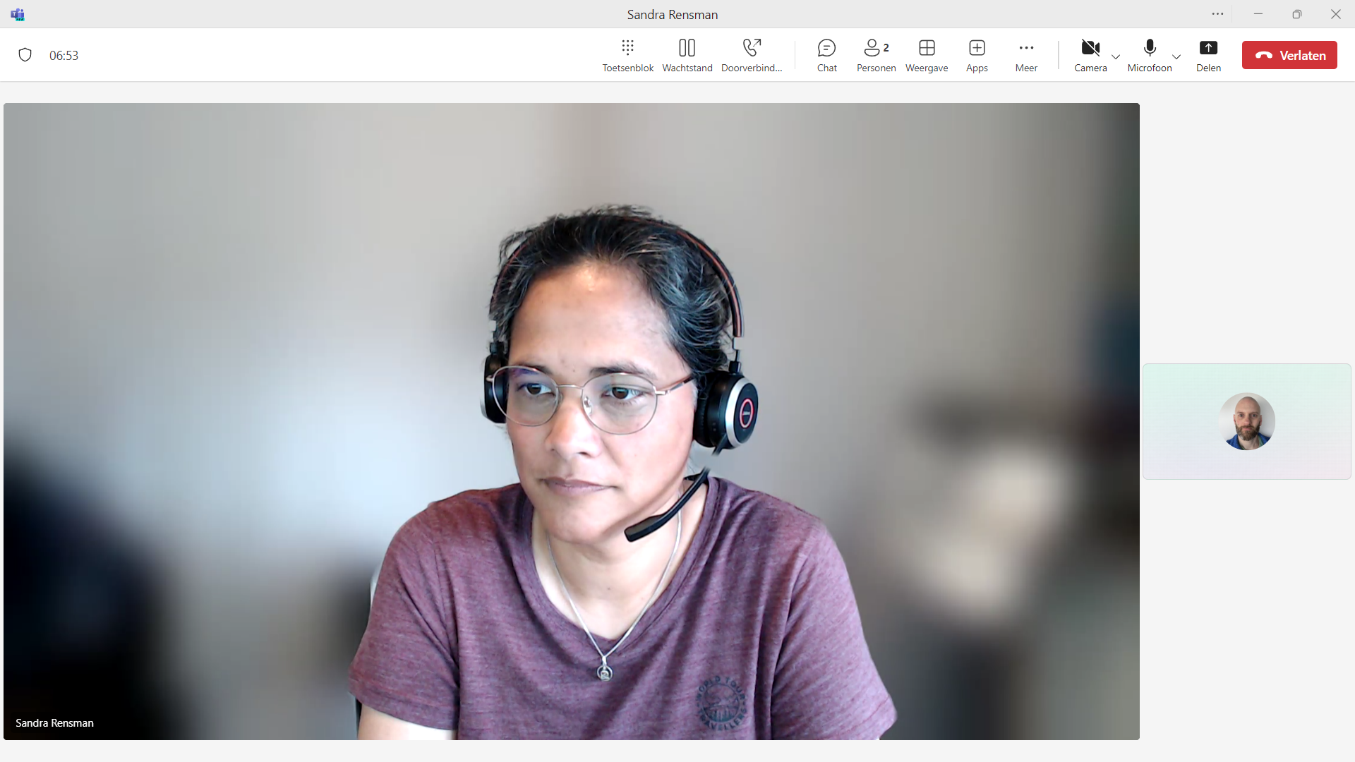
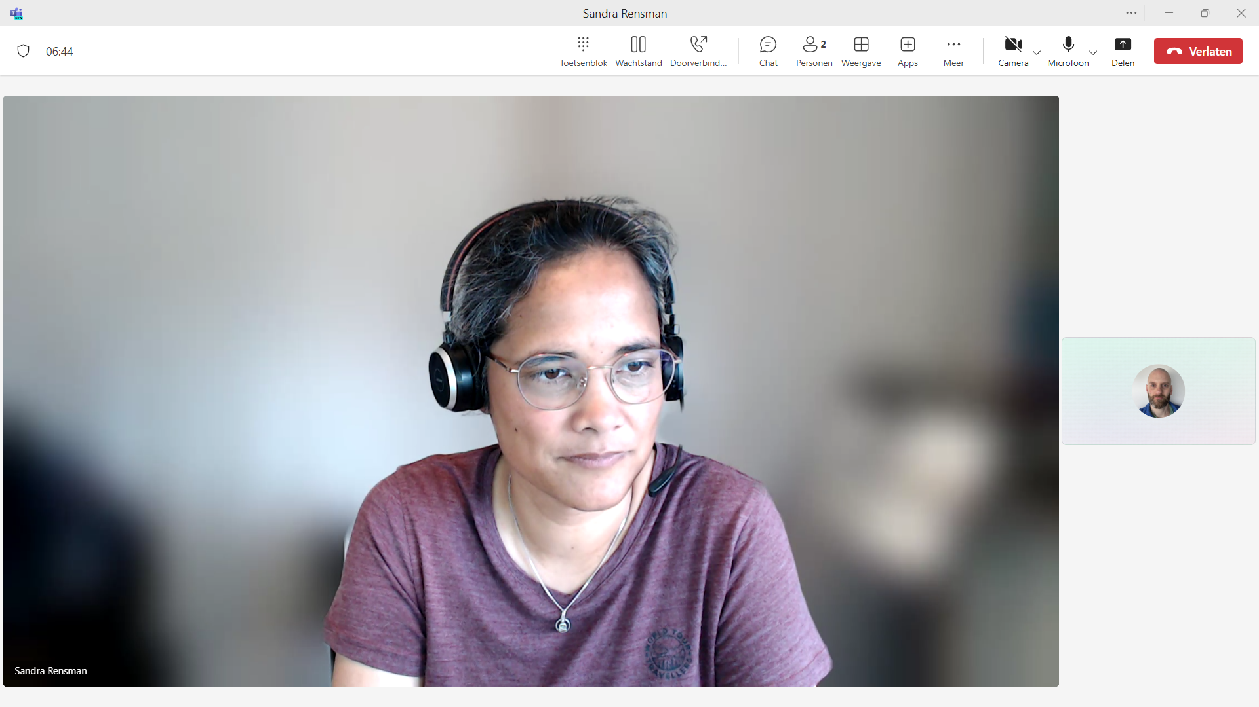
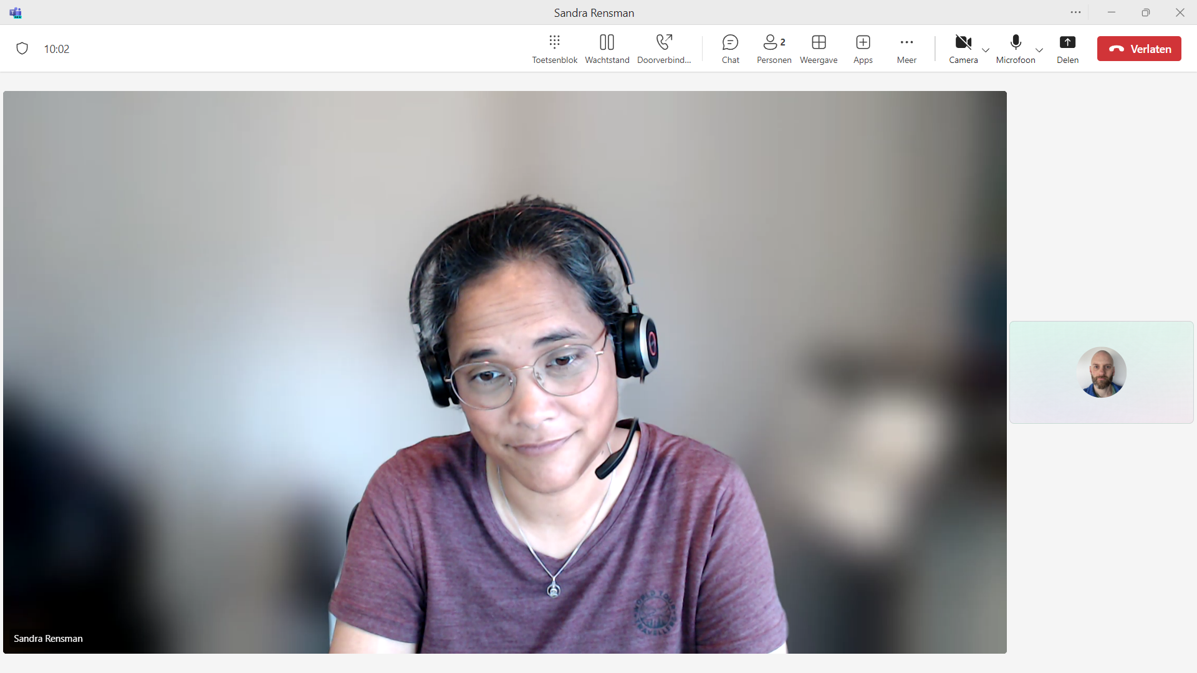
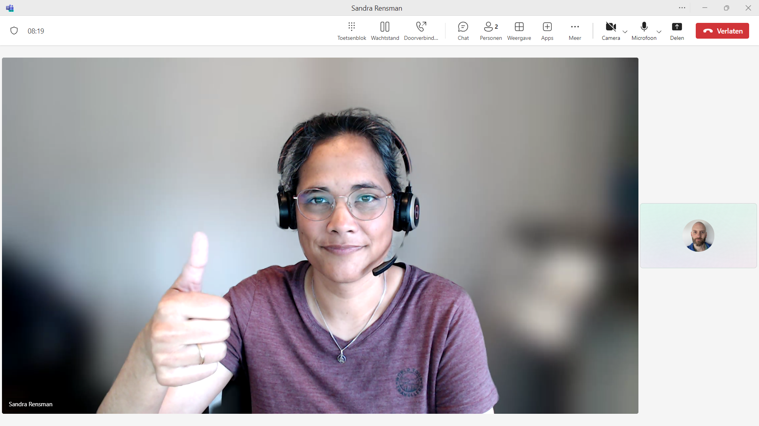
Notes:
Sandra inspecting the code and approving it

Slide 40
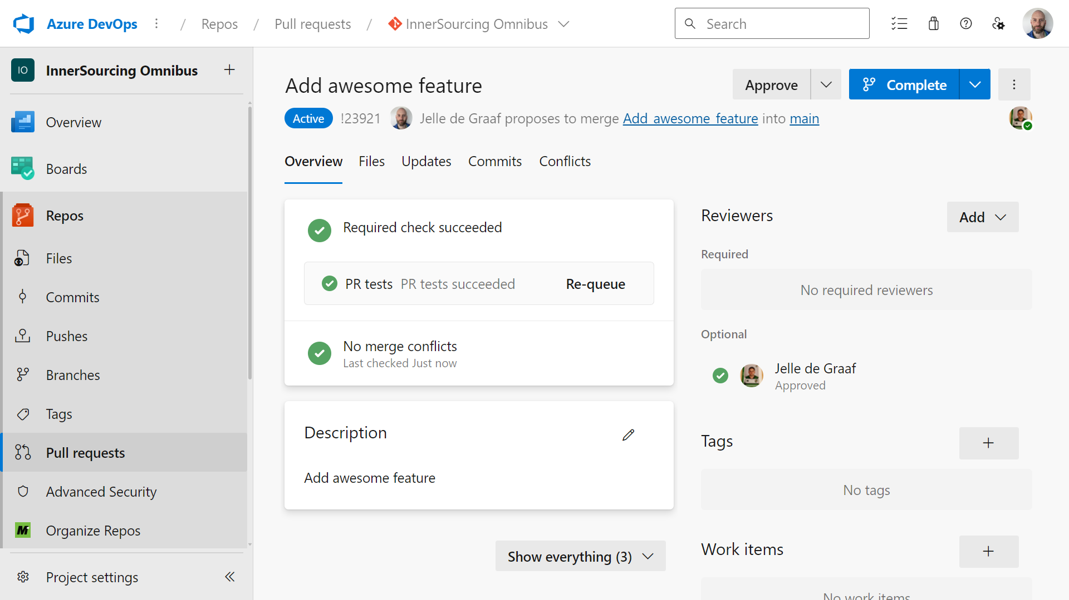
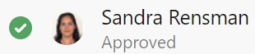
Notes:
Sandra checks the code and approving the pull request

Slide 41
Notes:
Neutral

Slide 42
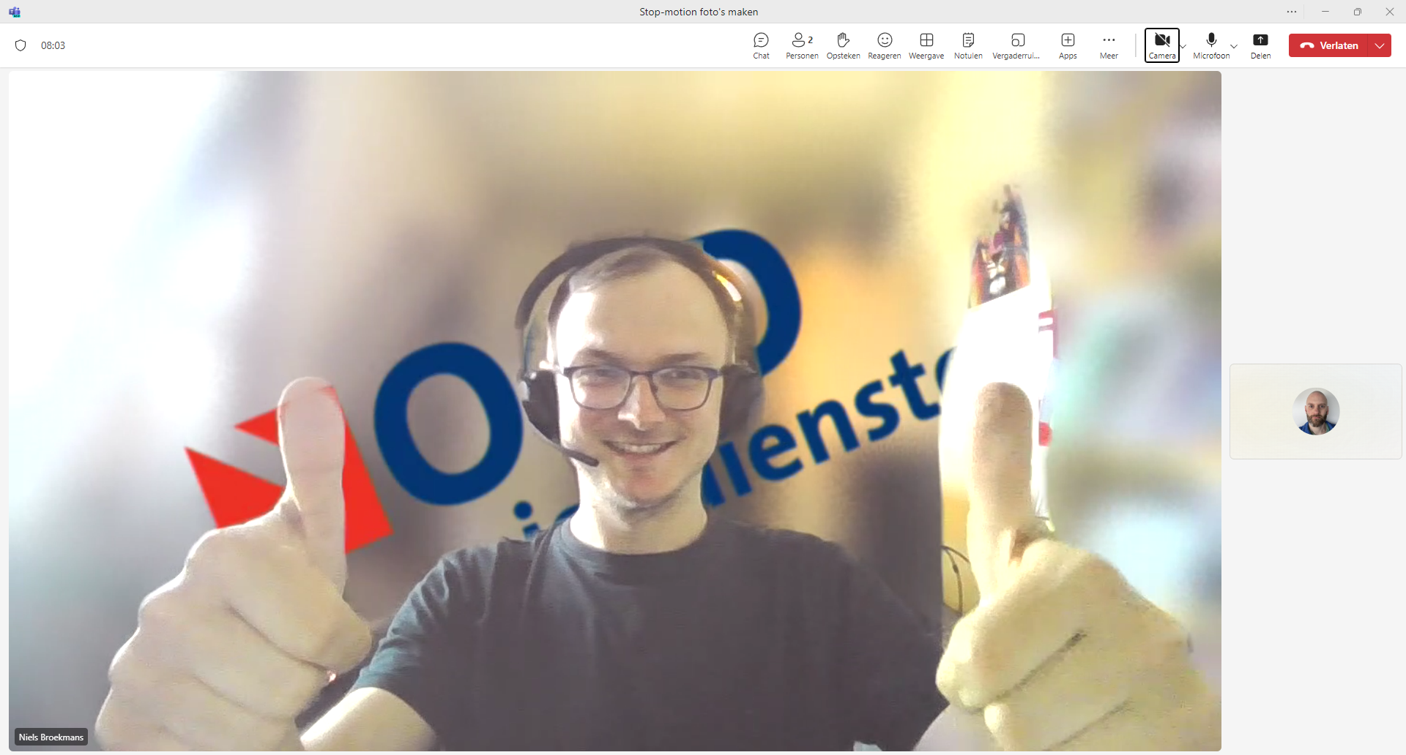
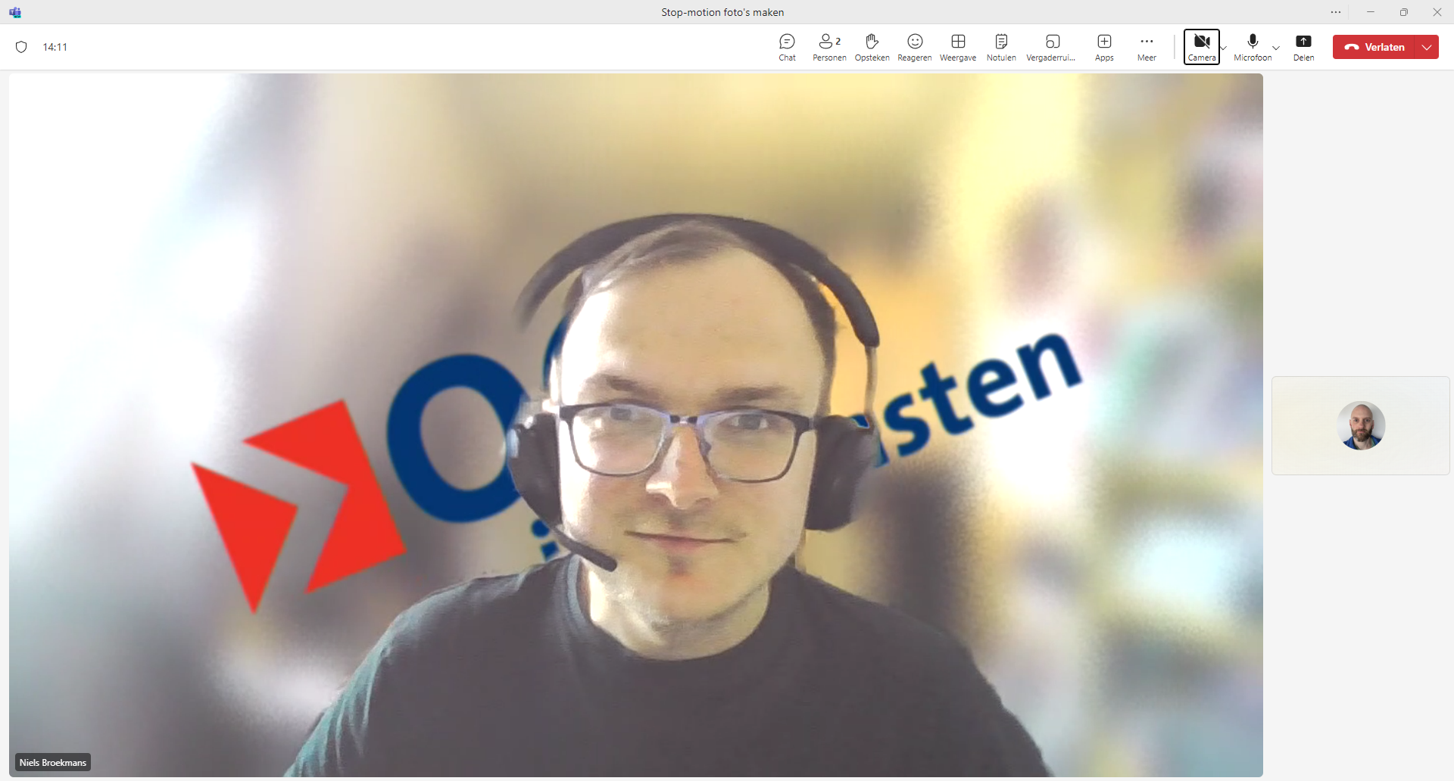
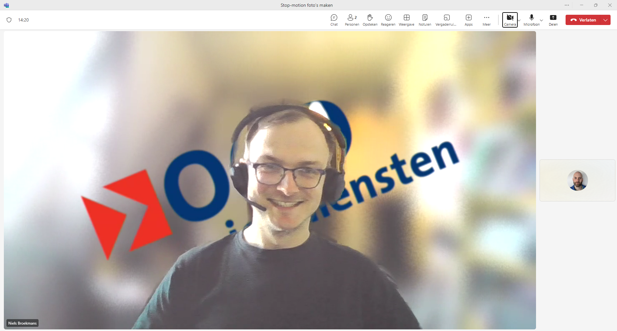
Notes:
Completing PR
Reading the screen
Happy/releaf

Slide 43

Notes:
Niels completes the PR and shows the updates main branch

Slide 44
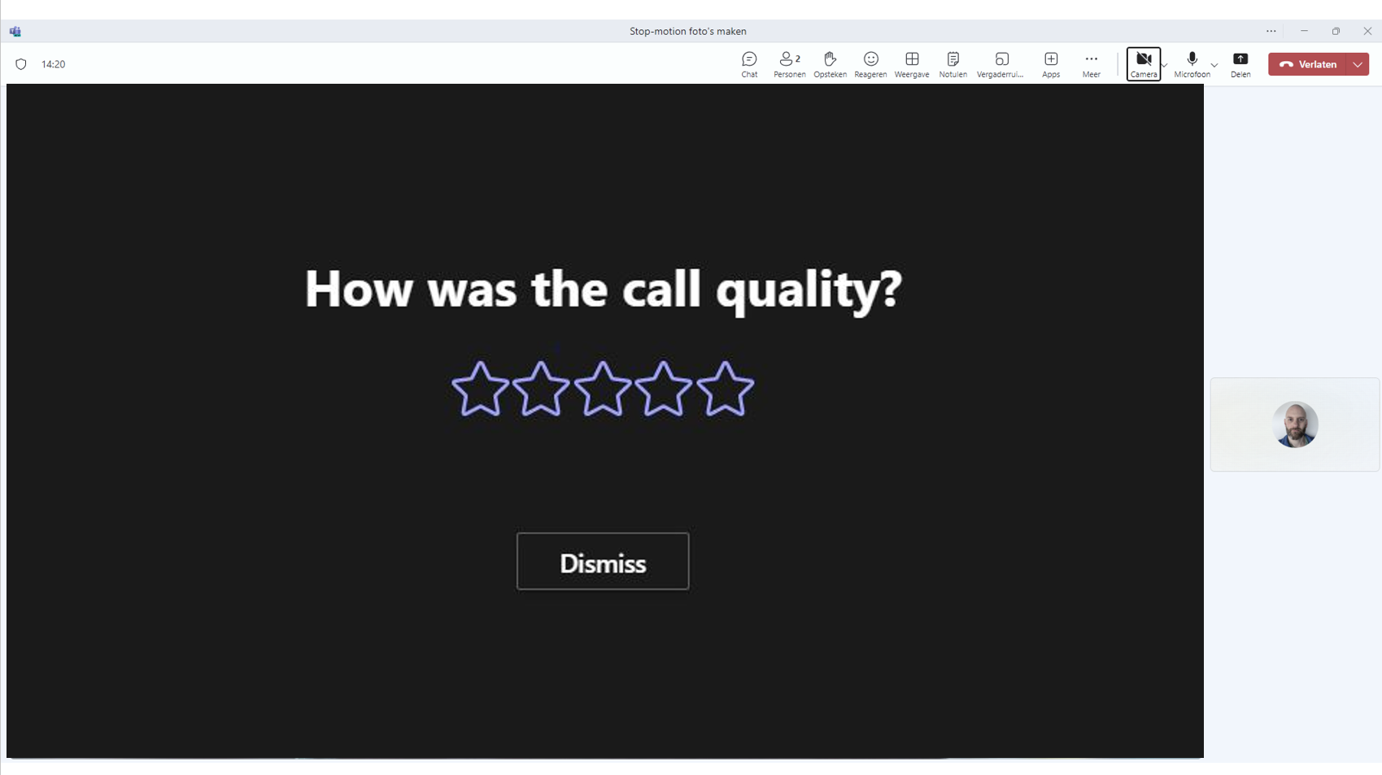
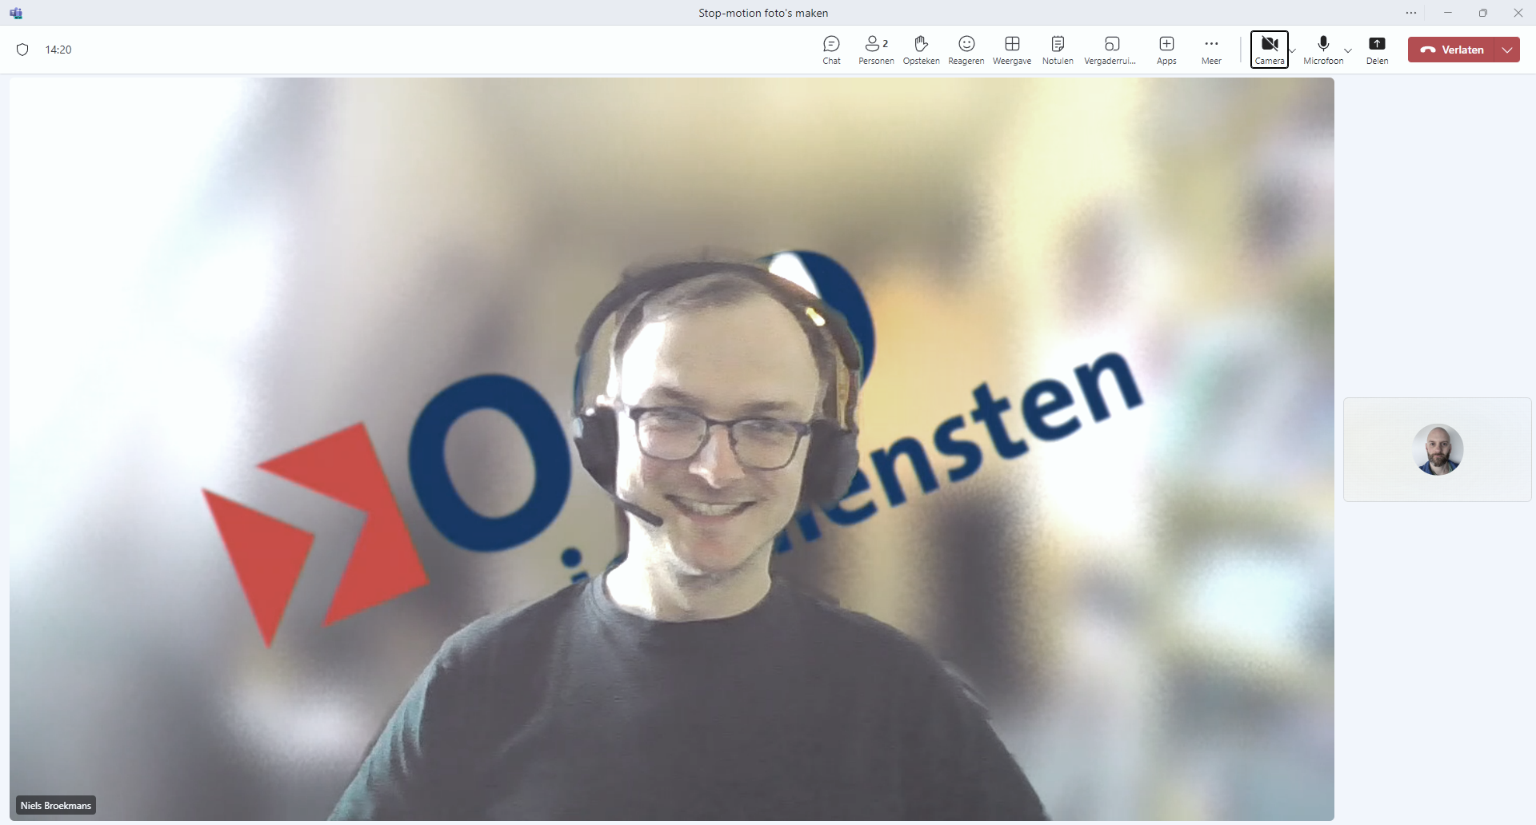
Notes:
Niels waves goodbye

Slide 45
Demos
We love Demos!

Slide 46

Tidy everything up
Notes:
Tidy everything up

Slide 47
Don’t tidy everything up
Basic functionality suffices
Production worthy? InnerSourcing worthy!
Notes:
Your codebase doesn’t have to be perfect. If it works, that’s often times enough.
Would you bring your code to production, or is it already? Then it’s good enough to open up for InnerSourcing. Don’t feel the need for every line of code to be pristine, just because more people will be looking at it.
Our reality: The project started with InnerSourcing straight away. Ok perhaps not for the first few weeks when things were organized, but right from the beginning, people from outside the creators were welcome to join.

Slide 48
Framework teams
Notes:
Framework teams

Slide 49
Teams
Product
A
Product
B
Product
C
Notes:
Let’s say there’s three products in your project, that need to be developed.

Slide 50


Teams
Product
A
Product
B
Product
C
Notes:
Every product requires code, tests, and documentation to be created.

Slide 51

Teams
Product
A
Product
B
Product
C
Notes:
If you focus on one product and finish everything that needs to be done for that product, before moving on to the next, you will deliver value as soon as possible.

Slide 52
Teams
Product
A
Product
B
Product
C

Slide 53
Teams
Product
A
Product
B
Product
C
Notes:
Sometimes, specialized teams are introducted. The can be called horizontal teams, who focus on a single part of a bigger whole. In this example, one team to write code, one for tests and one for documentation.

Slide 54
Teams
Product
A
Product
B
Product
C
Notes:
On one third of the time, when the code team has done all their work, no product has been finished yet.

Slide 55
Teams
Product
A
Product
B
Product
C
Notes:
…and after two thirds of the time, there’s a lot more boxes checked, but still zero finished products.

Slide 56
Teams
Product
A
Product
B
Product
C
Notes:
Only after the last bits of work have been done, finished products are delivered. If you focus vertically on a product, you can add value much sooner.

Slide 57
InnerSourcing won’t work here
Notes:
InnerSourcing won’t work here
Of course this can work for you! We gave it a go because we thought the organization and the project would both profit from it. We learned as it went along and adjusted where necessary. We ended up with a product of higher quality and that was more adopted through the organization than it would have been if we kept the development behind closed doors.
I’m sure you can make this work as well. Just keep a few things in mind

Slide 58
It will work for you
Just watch out for some pitfalls
Don’t expect free work
Make contributing interesting
Expect a long-term investment
Notes:
You will do most of the work yourself
Attract people and keep them interested in the project
InnerSourcing a project is a long-term investment. If you look at it from an hours spent objective, it can take a while to break even. It might not happen at all, but you can still be successfull because of the increased quality and adoptation.

Slide 59
Notes:
When you take all that in account, I sure you can change your mood from this… to this.
Thanks for your attention!

Slide 60
Sources
The open source way
https://opensource.com
Martin Woodward - The 5 Myths of InnerSource
https://www.youtube.com/watch?v=5NGqFAvBjGc
InnerSource Commons
https://innersourcecommons.org/

Slide 61
Q&A
15 minutes

